Slide 1
Lecture 12
Looking inside Cities: Spatial Structure and Neighborhoods
12.1 Neighborhoods, Community Organization and Local Sustainable Development
@Luís M. A. Bettencourt 2024
Photos by Anni Beukes
IUS 6.2

Slide 2

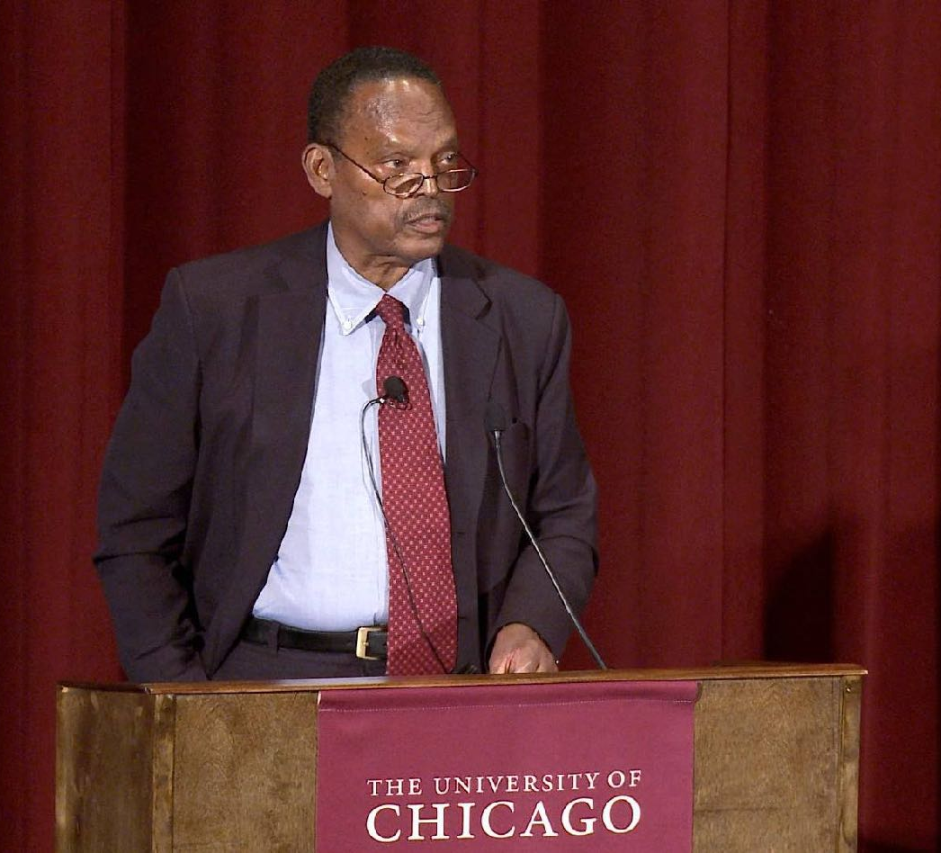
William Julius Wilson, 1987
Neighborhood Effects (in Chicago).
Notes:
We introduced the scale of neighborhoods via “neighborhood effects” as they were discussed since the 1980s, mostly in academia and policy. But the history (and methods) of studies at these scales is much longer, and is well grounded on community organization and civic movements. We will spend a little of time on these issues in this module. Although this may seem far from “science”, there is a clear logic about these movements, that is certainly part of urban science.

Slide 3
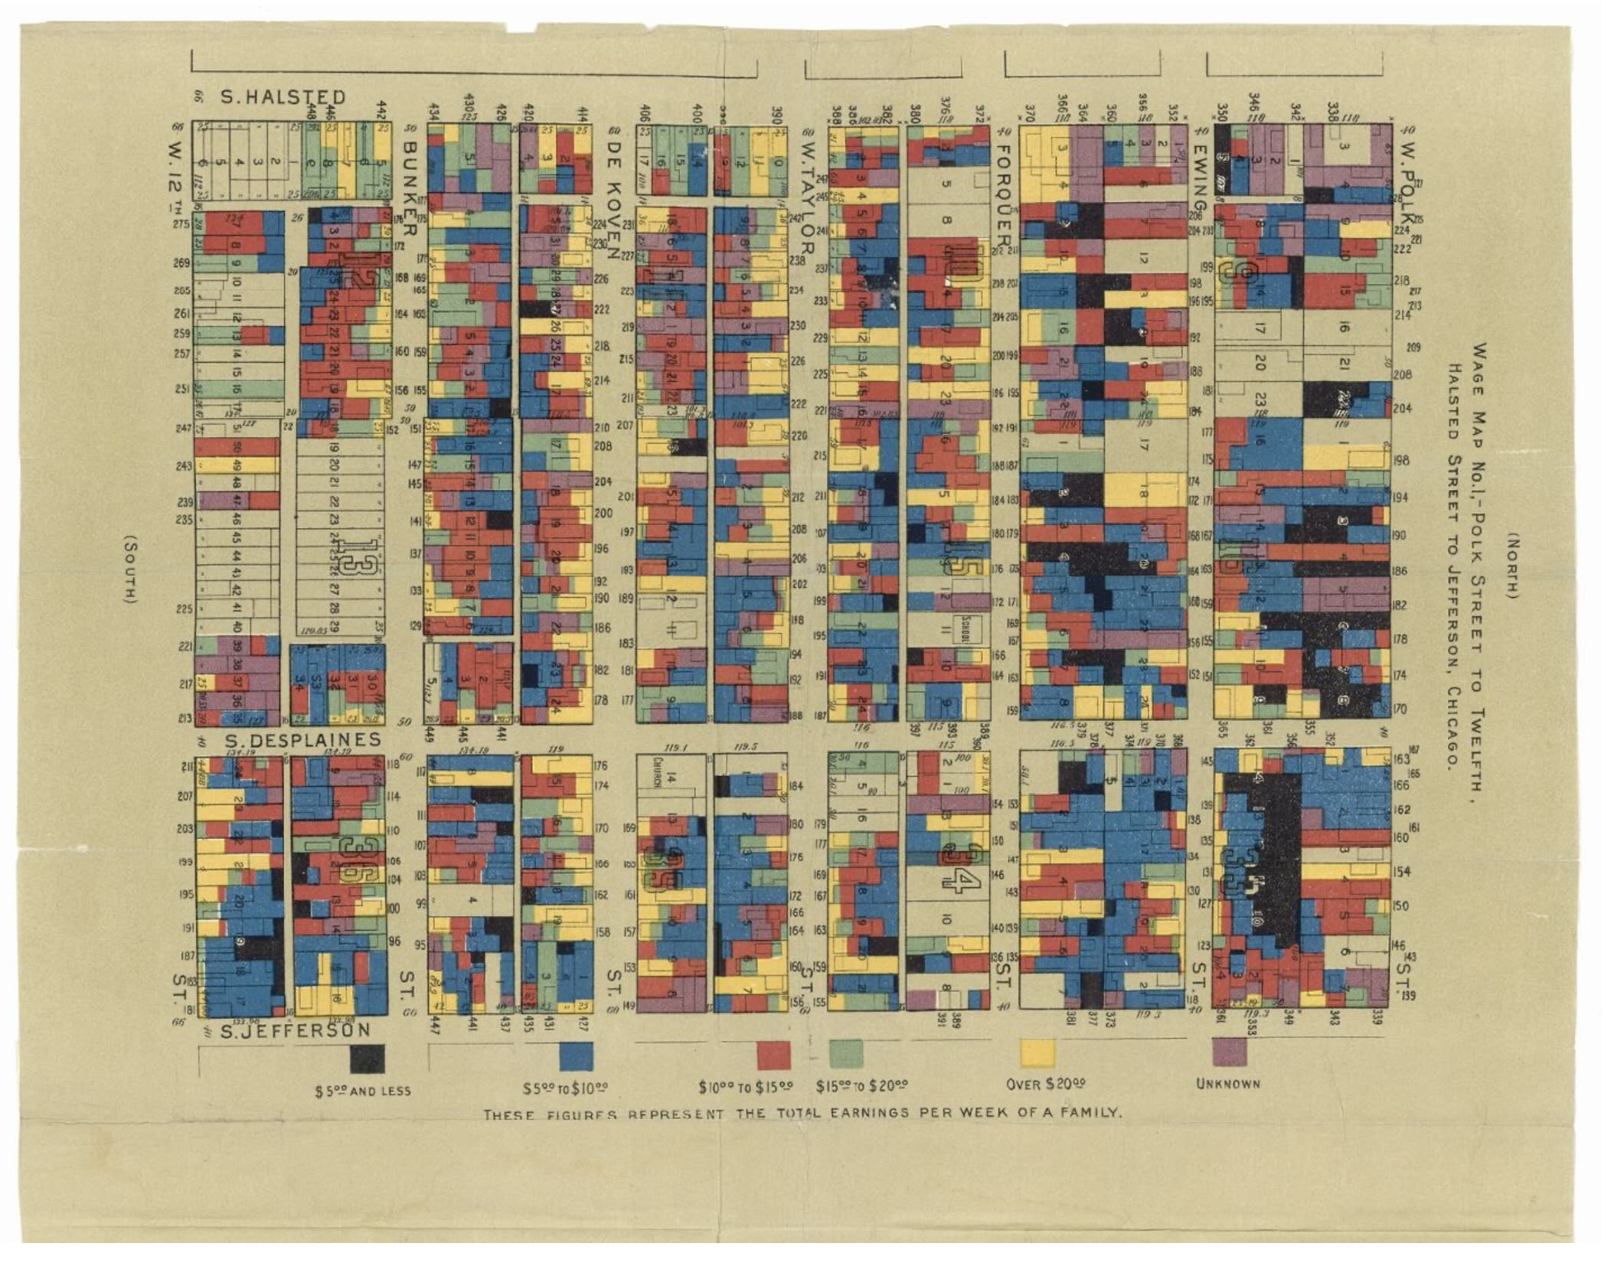
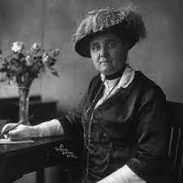
“for their assiduous effort to revive the ideal of peace and to rekindle the spirit of peace in their own nation and in the whole of mankind”
Jane Addams
Nobel Prize 1931
Hull-House Maps and Papers , 1895
http://www.encyclopedia.chicagohistory.org/pages/410008.html
C. F. Charles Booth’s Maps of Poverty in London,
Notes:
You will recall Jane Addams and Hull house from Lecture 2. More than the data and the maps, the objective was for civic organizations on the ground to demonstrate the complexity of issues of poverty and human development and, from the perspective of knowing more, propose better solutions.

Slide 4
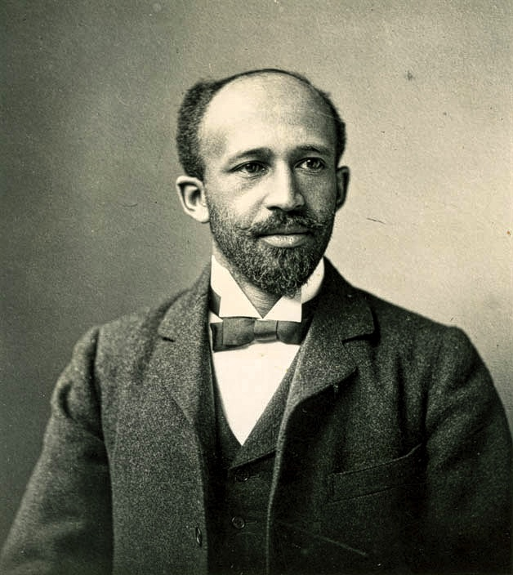
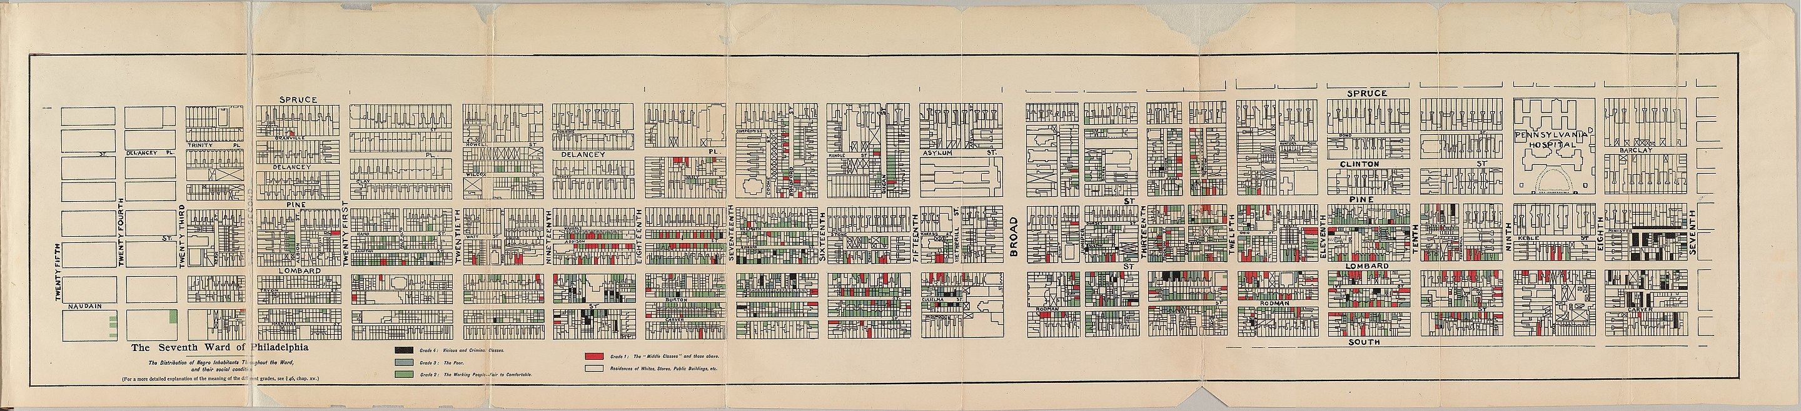
“not one problem, but rather a plexus of social problems,”
"the Negro problem […] is but the old world questions of ignorance, poverty, crime, and the dislike of the stranger."
W. E. B. DuBois, The Philadelphia Negro 1899
http://stillfamily.library.temple.edu/exhibits/show/william-still/maps/w-e-b--du-bois-seventh-ward-ma
Notes:
Likewise WEB Dubois wanted this sort of data to destroy prejudiced and lazy associations between race and income, and reveal the systemic nature of real life.

Slide 5

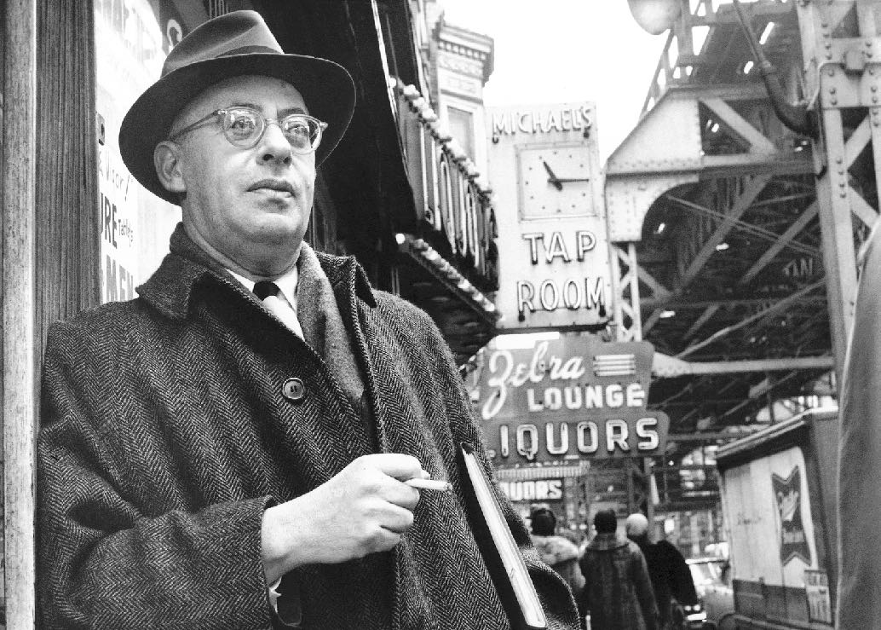
Saul Alinsky in Woodlawn, Chicago 1962
“Father of Community Organization”
1971
“As an organizer I start from where the world is, as it is, not as I would like it to be. That we accept the world as it is does not in any sense weaken our desire to change it into what we believe it should be – it is necessary to begin where the world is if we are going to change it to what we think it should be. That means working in the system.”
— Saul Alinsky in Rules for Radicals
Notes:
The fact that local communities and organizations know more about their own problems is destabilizing for top down politics (and academic policy). But it is also the structural position of these organization in (urban !!) society that allows them to coop laws and procedures of the city to demonstrate harm and injustice, and sometimes propose solutions. Back in Chicago in the post-WW 2, Saul Alinsky (a drop out from UChicago Sociology, he found it boring apparently) codified some of these tactics, which were used in labor and racial struggles in the City. Because of its history of inter-group conflict Chicago also became a laboratory for civic innovation and methods of community organization.

Slide 6
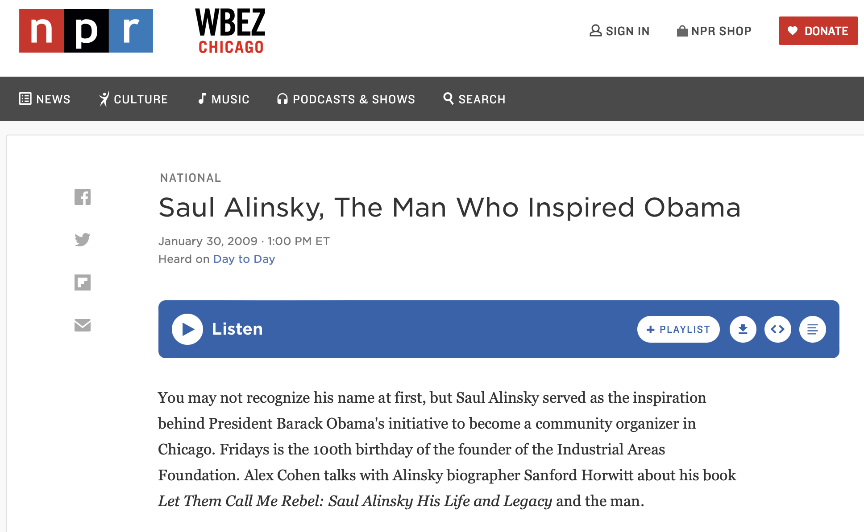
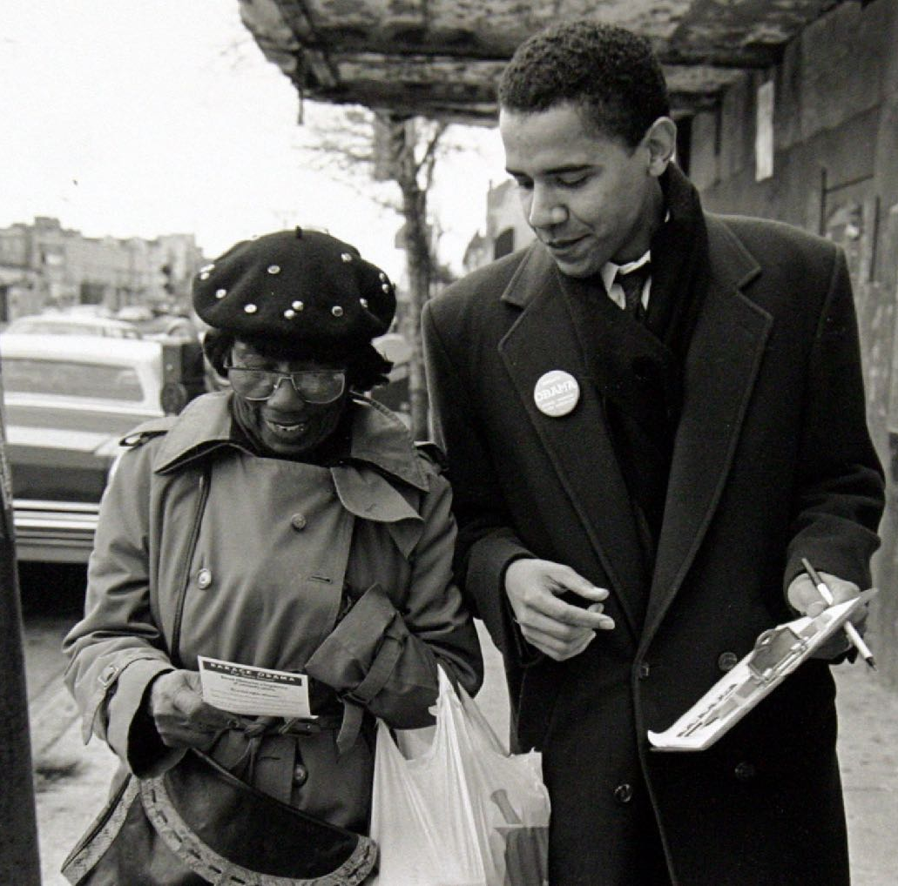
https://www.npr.org/templates/story/story.php?storyId=100057050
Notes:
The power and achievements of these methods rely on collective organization and action, but also the existence of laws and procedures in cities (and states) that in principle protect minorities and create rights, but that are often unfairly absent in practice. This tradition of community organization in Chicago was part of the school of civic leadership that inspired, and supported, a young Barak Obama. His Presidential Library will be in the Woodlawn neighborhood, where Saul Alinsky was standing in the previous photo. Alinsky remains a very controversial figure…

Slide 7
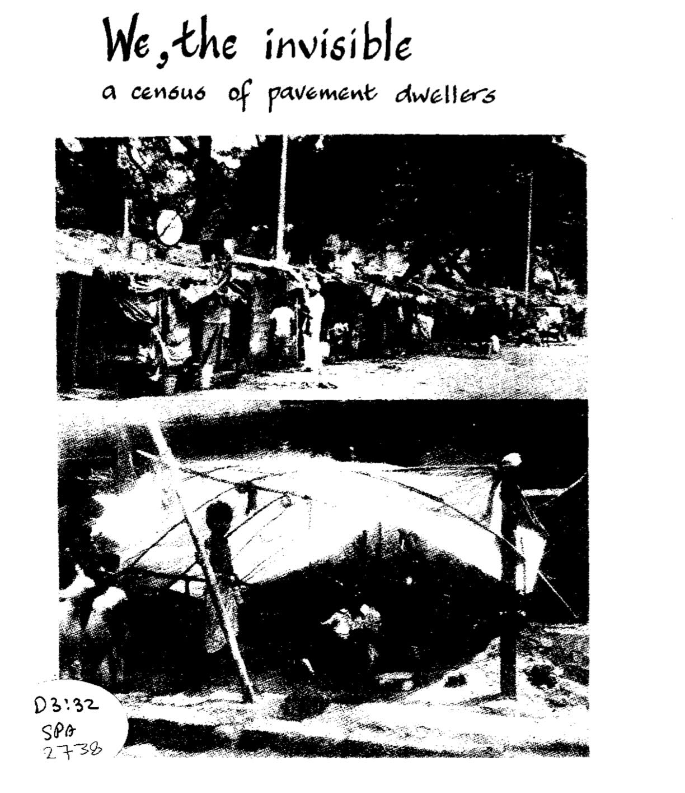
Mumbai, India
1985
https://en.wikipedia.org/wiki/We,_the_Invisible
Notes:
It has been argued that many of the concepts of community organization developed in Chicago (and in the US and Europe more generally) became too confrontational, and were often stronger in showmanship than results. These ideas travelled, and were reinvented and improved in Indian and Africa today. An important landmark on the theme of poverty and neighborhoods, was “We the Invisible” in Mumbai India in the mid 1980.

Slide 8

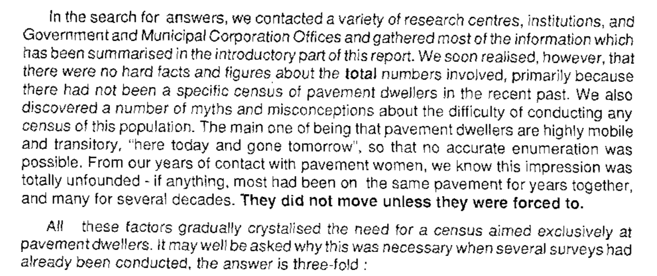

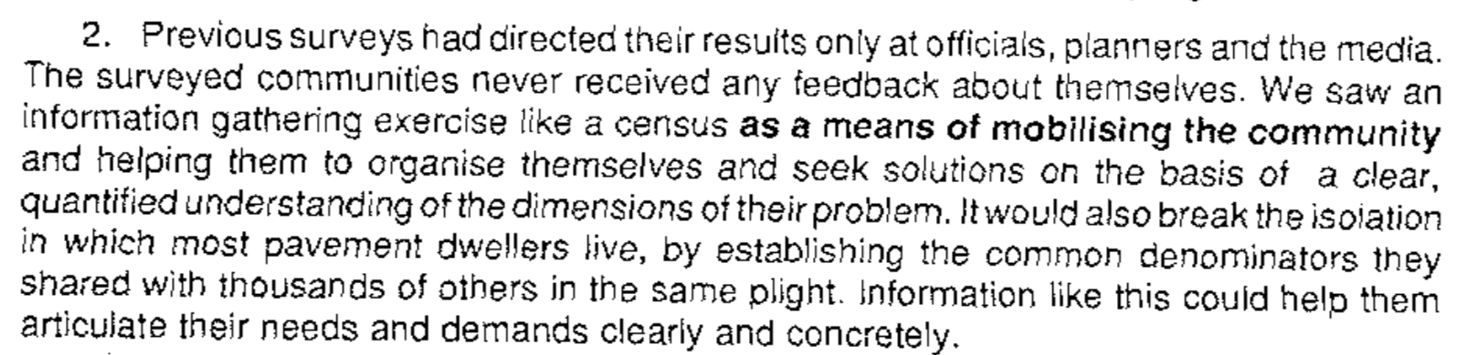
https://sparcindia.org/pdf/articles/We The Invisible.compressed.pdf
Notes:
This document - and the process behind it - go back in many ways to Dubois and Addams, in creating data (a detailed census) of a problem that had been wrongly objectified (pavement dwellers). It uses Alinsky methods in inverting the logic of census as a government document, by creating it from the bottom-up by the community and showing that it is of superior quality and insight than what the authorities produce. These methods allow poor communities to gain power through their own knowledge and quality data, “Knowledge is Power” as they say (echoing Francis Bacon and the origins of the scientific method).

Slide 9
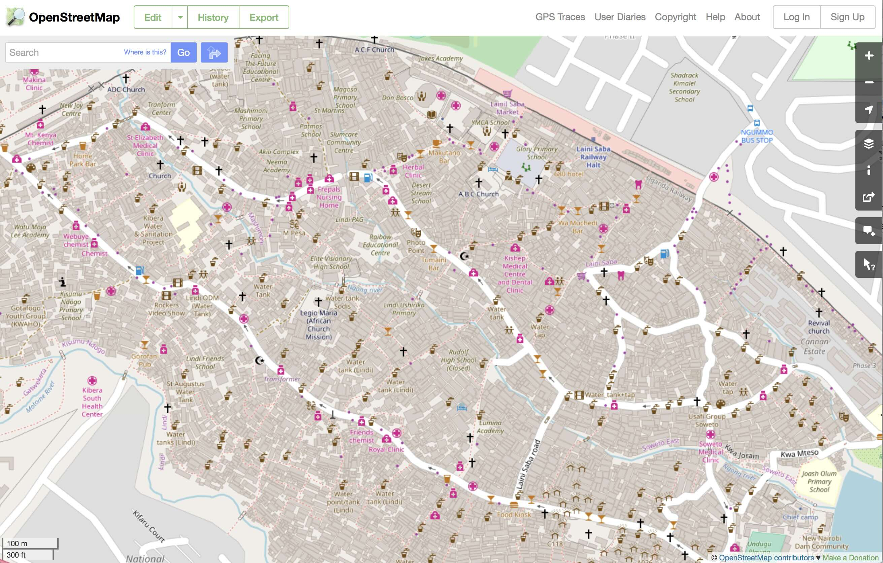
Kibera, Nairobi, Kenya
Notes:
These methods of population census of previously unmapped and underrepresented disadvantaged populations have gained strength through a convergence of developments, including detailed mapping of informal settlements (here in Nairobi, Kenya) made possible by crowd sourced platforms, such as OpenStreetMap (you should help map the world too).

Slide 10
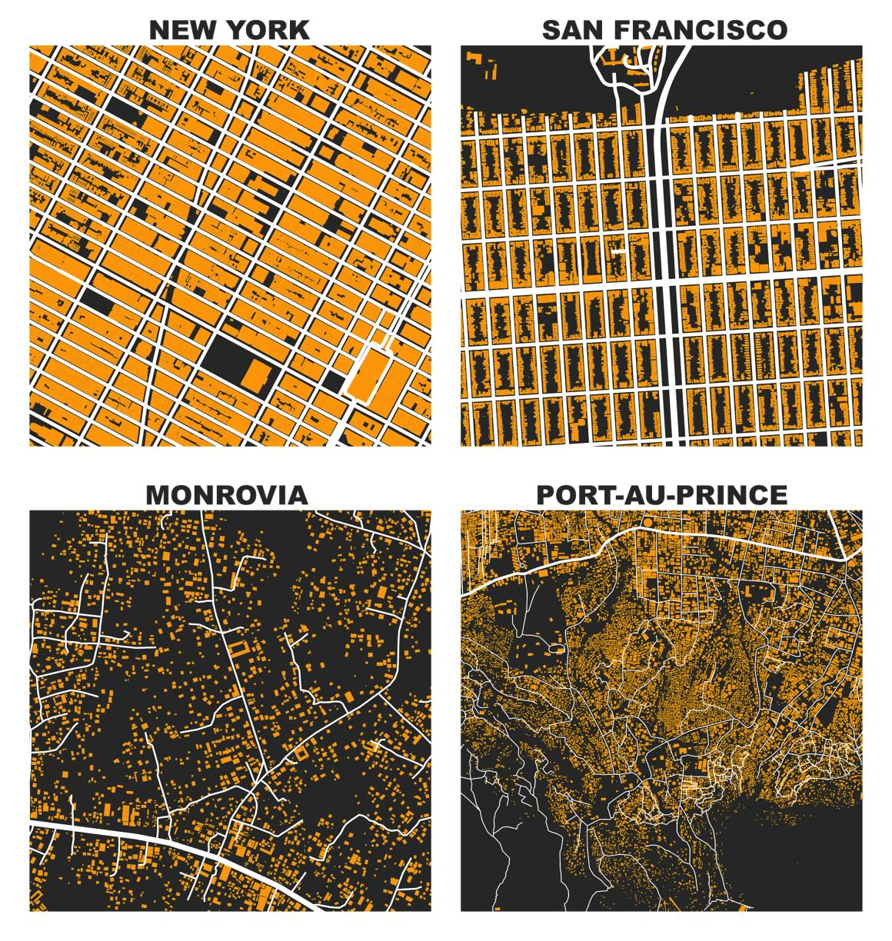
This is the kind of knowledge
we are getting now:
every shack and every building,
every road and path
existing services,
addresses,
emergency services
flooding, fires,…
community + city priorities
everywhere.
credit: Geoff Boeing
openstreetmap
Notes:
This kind of data is mapping every building, street and amenity everywhere on the planet. This is revolutionizing not only our understanding of cities but empowering new communities and new collaborative approaches to development that are truer to each place and population.

Slide 11
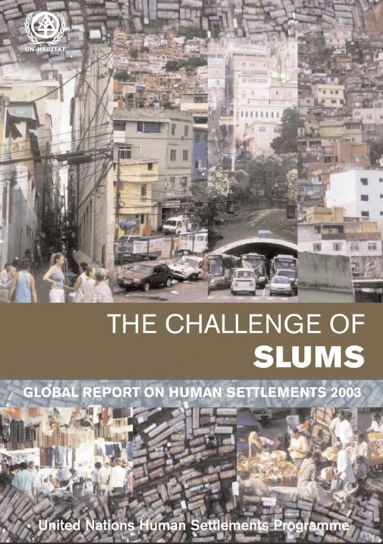
The starting point:
Notes:
The challenge of informal settlements (sometimes refereed to as “slums”) is particularly severe, and has become a focus of international development policy during the Millennium and then Sustainable Development Goals. This UN report in 2003 defined (maybe for the first time) the issue as global, and brought it to the attention of the international policy community.

Slide 12
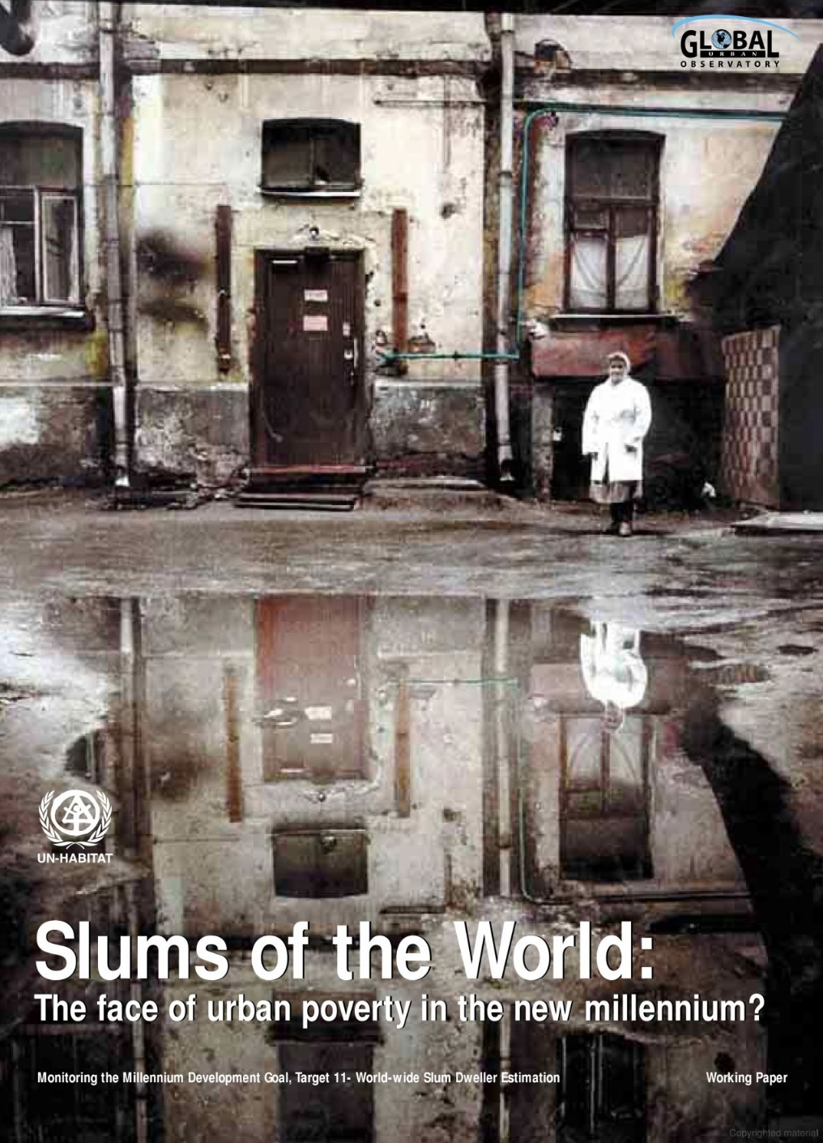
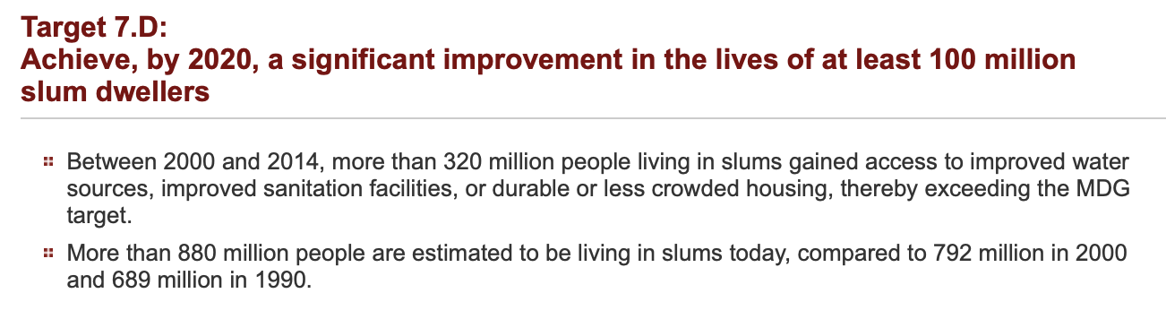
‘The absence of data from large areas of the world on slum indicators
substantiate the view that these precarious settlements are still
“zones of silence”
in terms of public knowledge, opinion and discussion about urban poverty’
Millennium Development Goals
—UN-Habitat 2003
Notes:
Early depictions of “slums” in these documents were simplistic, and imported typical cliches such as “zones of silence” to really be talking about what international agencies knew of the problem and not the state of local lives. Nevertheless, these ideas quickly lead to international efforts to alleviate extreme poverty and an attention to place and community, which were very positive.

Slide 13
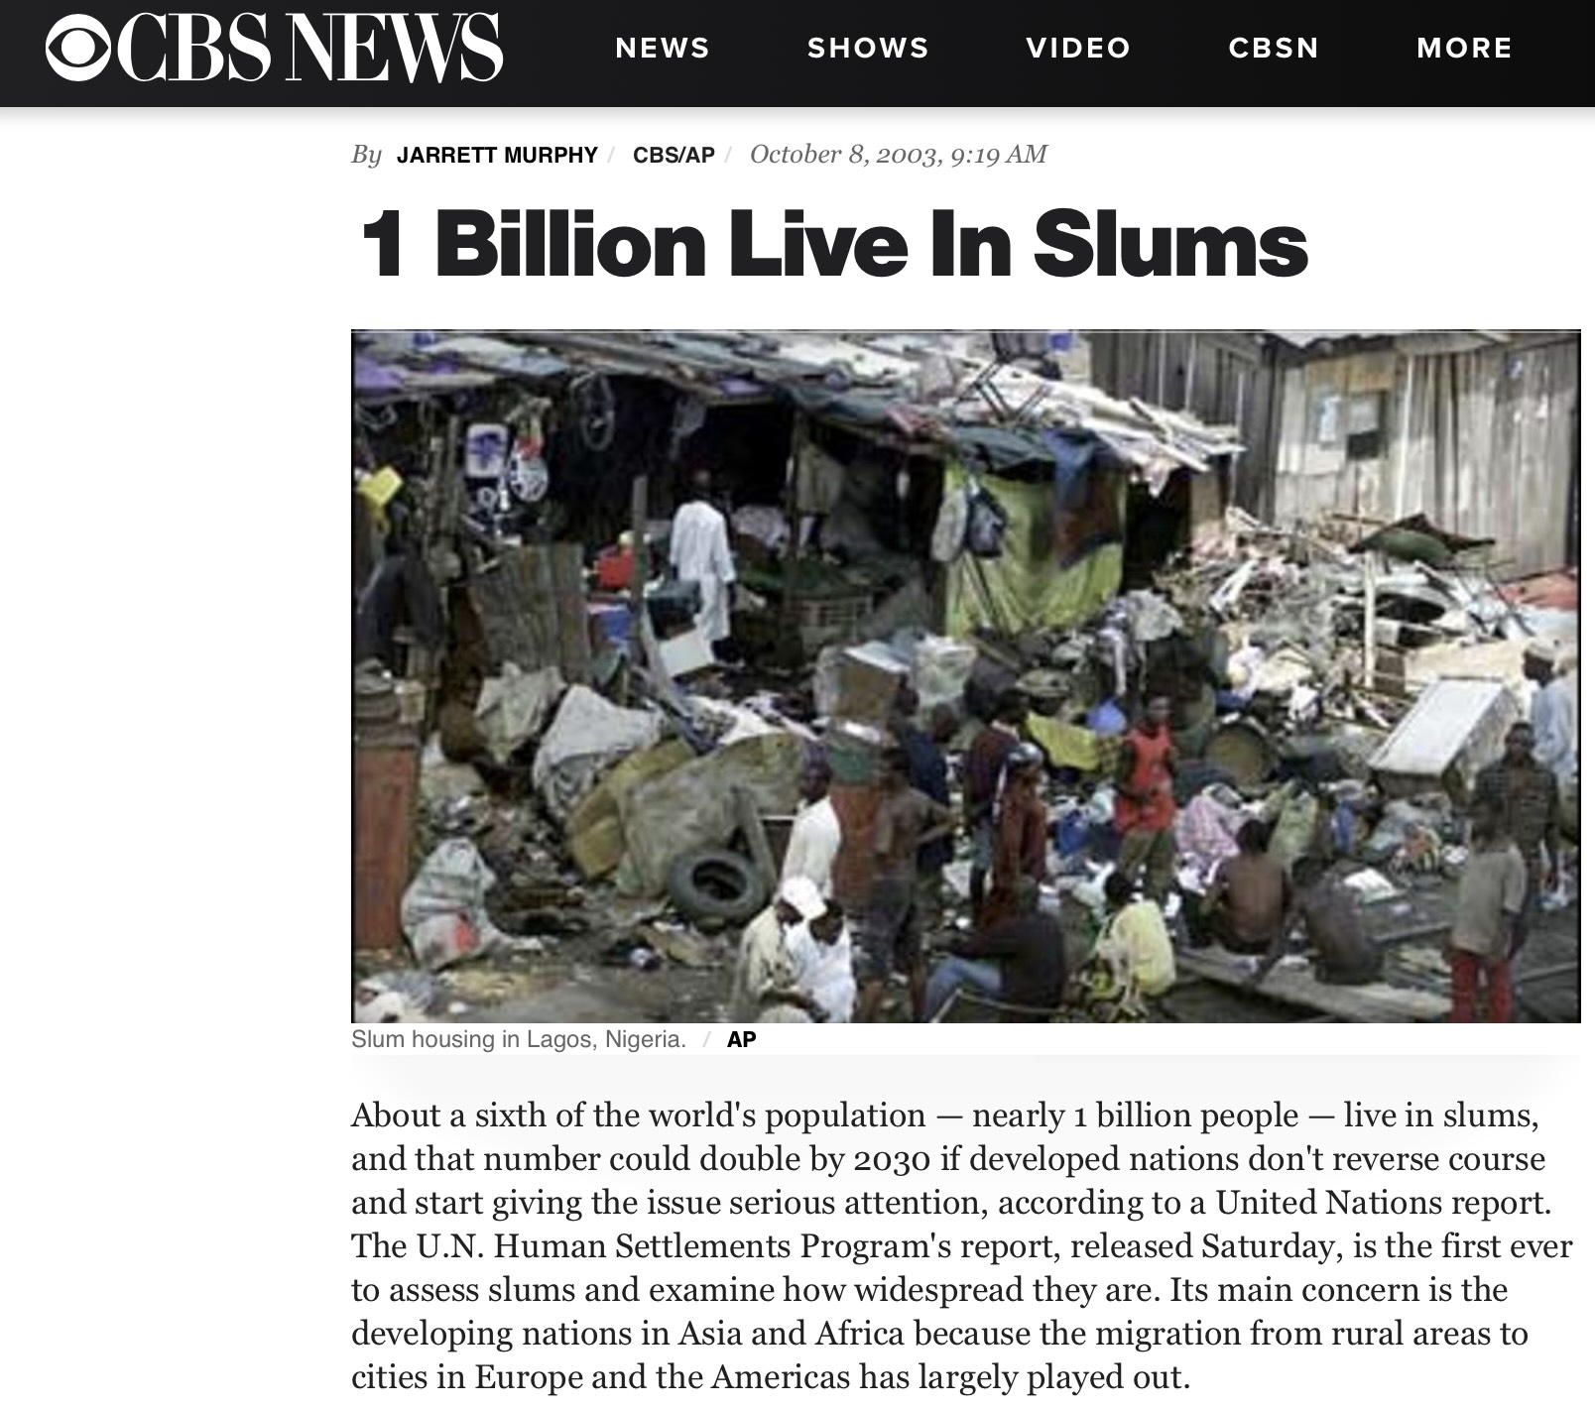
UN estimate 2003
Notes:
The number of people living in slums at the time was estimated as 1billion (or 1 in 7). Today, twenty years later, that number has been estimated at 1.1 billion (but a smaller proportion of the total population, or 1/8). These numbers are very approximate and rely on somewhat subjective (and hard to measure) classifications what is and is not a slum.

Slide 14
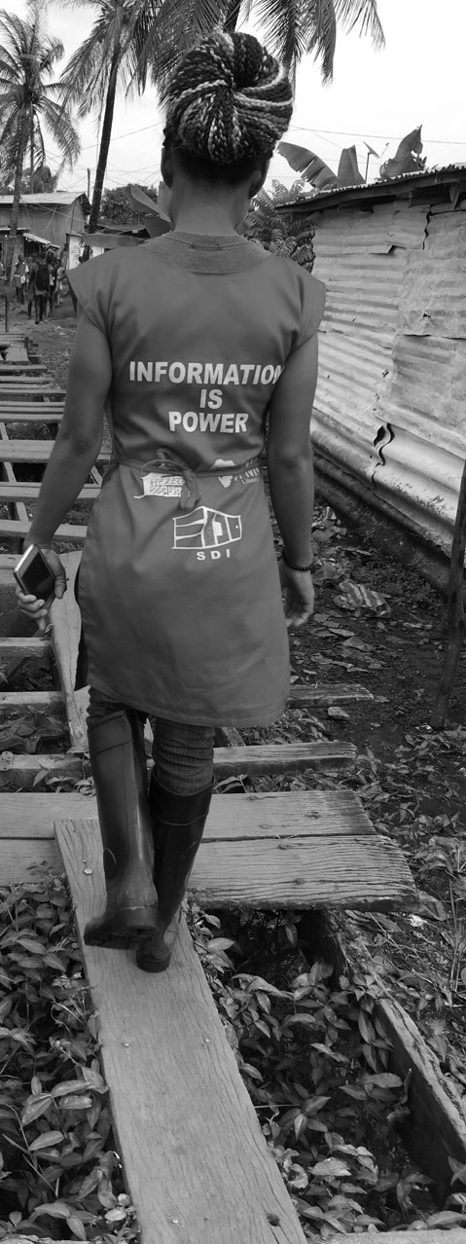
Making the Invisible Visible
Generating data on slums at local , city and global scales
@AnniBeukes
Resident Fellow
Mansueto Institute
for Urban Innovation
Notes:
Anyway, the stage was set for neighborhood effects and community organization methods to go global, gaining a footing in each community around the world, identifying issues of human development and solution pathways. These slides are by Anni Beukes, who worked in the Know Your City Campaign, a pioneering effort to create global data collections of slums, one neighborhood at the time. It is difficult but joyous work that is growing in importance today and into the future.

Slide 15
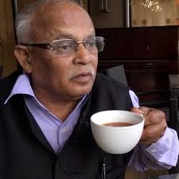
Principles of Community Organization
1.Begin with the poorest and most vulnerable communities to ensure all are included.
2.The greater the vulnerability, the greater the motivation of the community to act and bring change.
3. By organizing communities into networks and federations according to the lands they occupy it is easy to manage the large numbers of urban poor in the city.
4.When communities organize city-wide, they bring together their collective knowledge and resources to address their specific and collective needs.
5. Caring for each other develops capacity to think about each other’s problems and solutions.
6. Collecting savings and information are essential tools to organize communities and build their collective power.
7. When communities do their homework and organize, they build capacity to find alternative solutions that work for themselves and the city.
8. When communities are prepared with facts and workable solutions it builds trust and opens the doors for engagement with government.
9. Women are natural organizers. Their instinct to protect their children and families make them invaluable agents of change.
10. By creating separate and safe spaces for women to organize, young and adult women do not have to compete with the traditional leadership.
11. When members of the community build trust in each other they can solve big and small problems.
12. Regular community meetings and exchanges open the space for collective learning, reflection and consolidation.
13. When communities implement projects they build capacity to influence policy and practice.
14. Everything is workable when communities are organized.
Jockin Arputham (NFSD)
Place-based- Inclusion - Agency - “Collective Efficacy” - Information
Notes:
From the point of view of communities and NGOs, many of the ideas of early community organization continue to be developed as sets of principles, transferable to new organizations in other places. These are some of the principles guiding Slum Dwellers International (and the national federation of slum dwellers), out of Mumbai, by their founder Jockin. Note the elements of learning and information, as well as collective support and power.

Slide 16
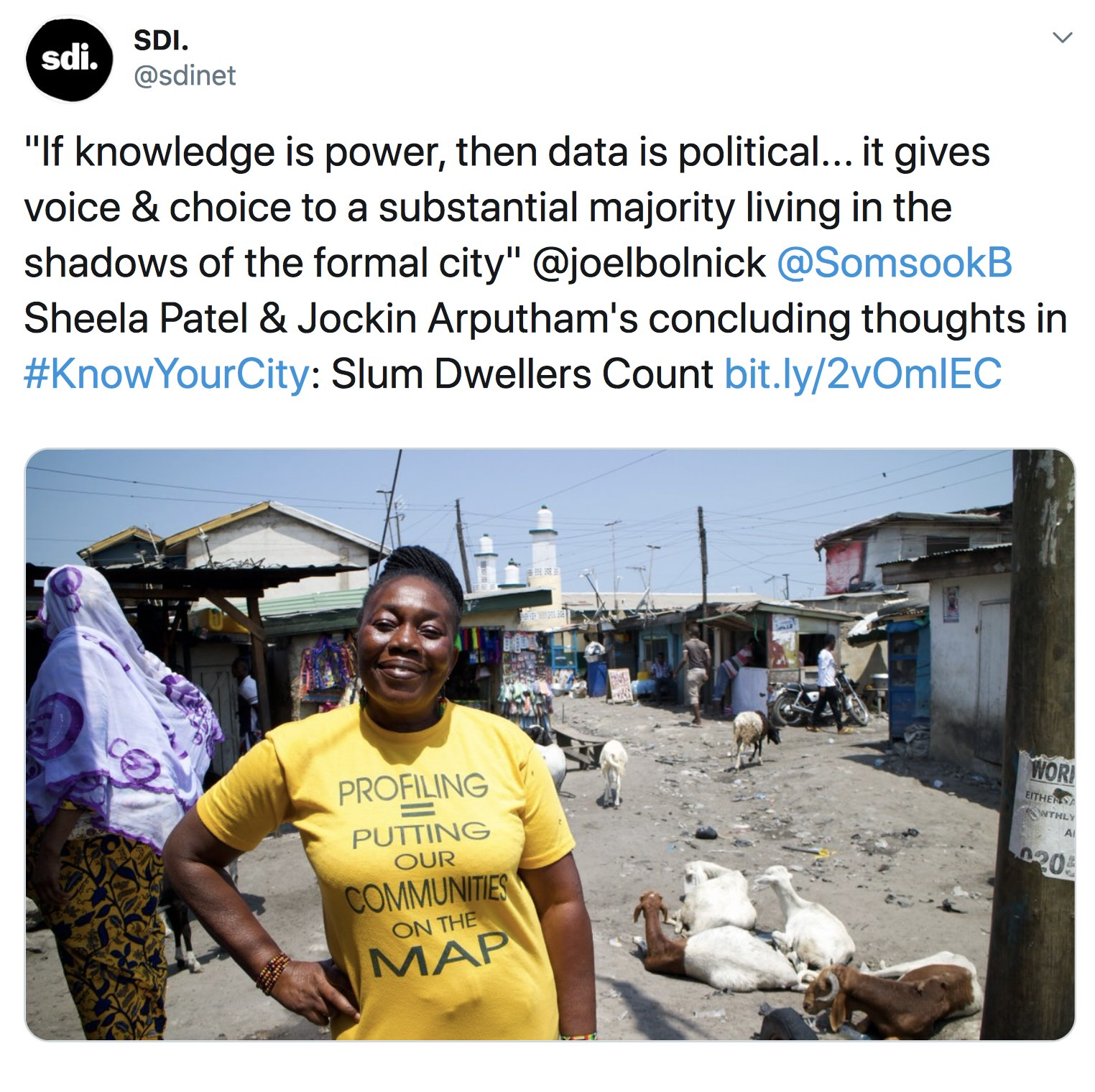
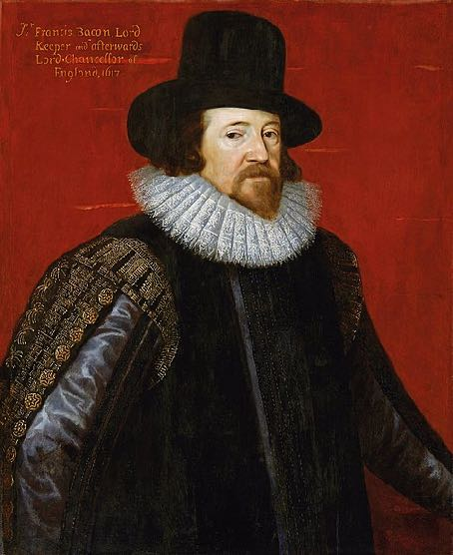
Communities are the experts on their neighborhoods
Francis Bacon 1597
Notes:
The fact that becoming visible and gaining power through knowledge and data its possible is in itself a very urban phenomenon, but it is something real and alive throughout the world today. In the US, we often (normatively) think otherwise, that privacy and individual choice are solutions: Discuss.

Slide 17
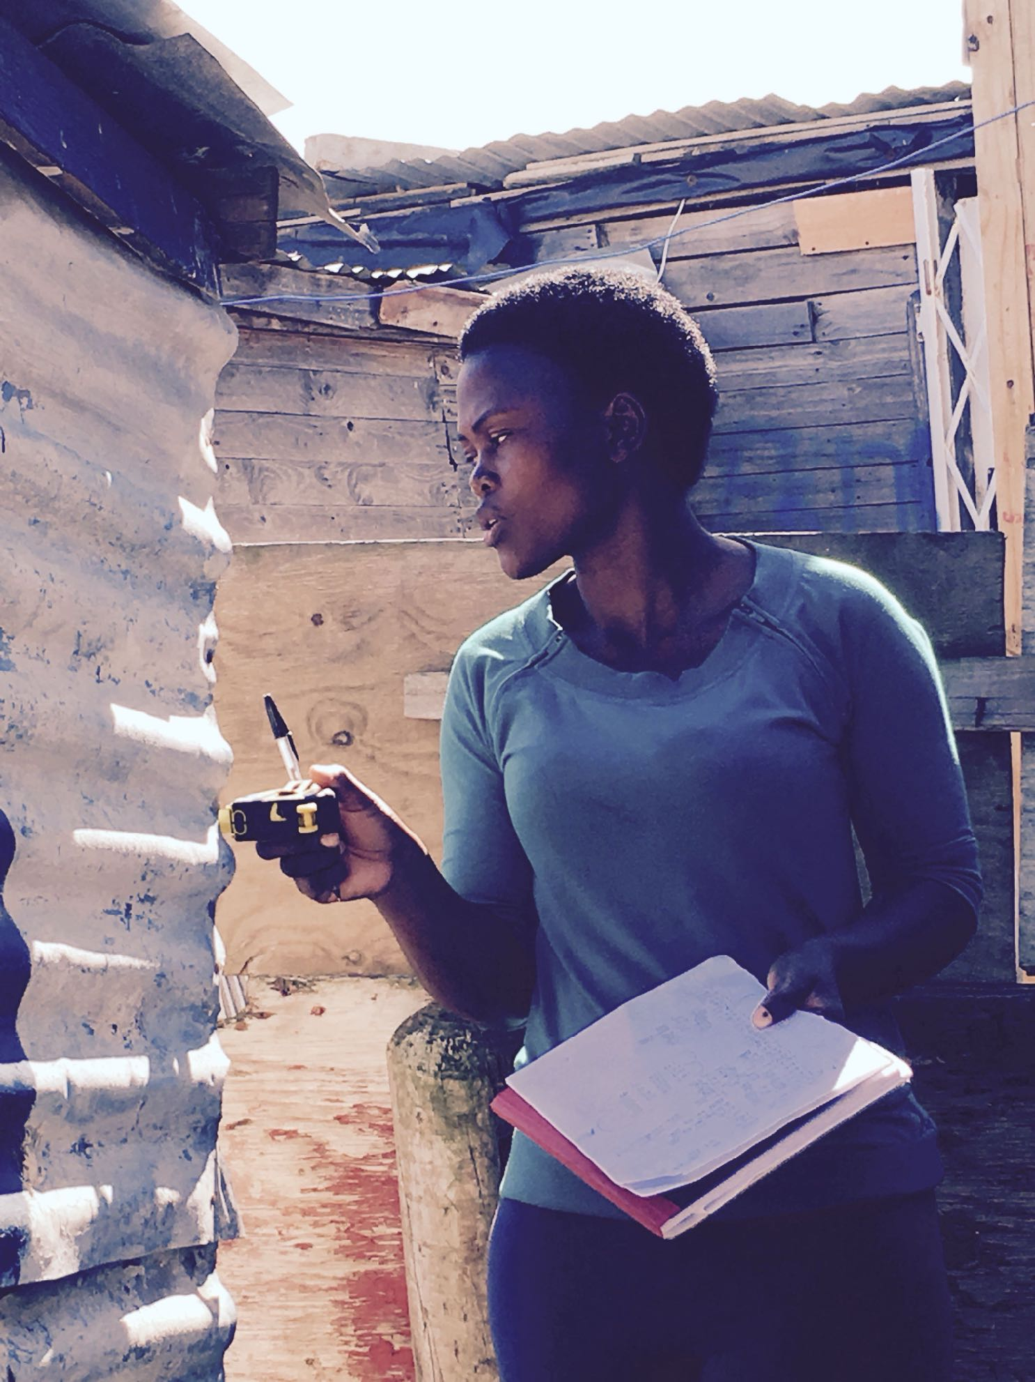
The Challenge
Aggregate and digitise network wide slum profile database (+/-10K records)
Design and implement digital tools for the standardised collection of slum settlement data
Design and built global online data platform for collecting, analysing , reporting and sharing slum profile data
Notes:
These slides just describe the Know Your City campaign, of how to take these processes to a large scale of tens of thousands of neighborhoods, with strong community to community (peer to peer) learning.

Slide 18
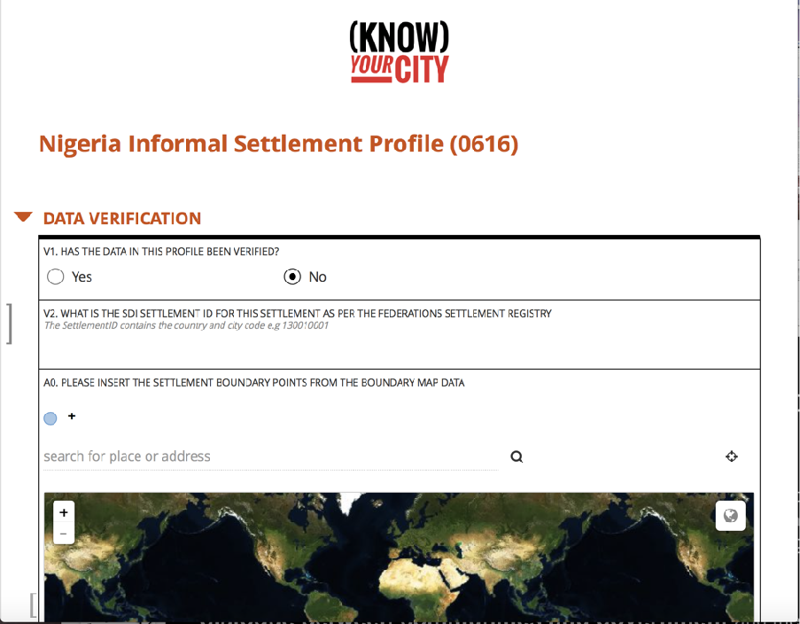
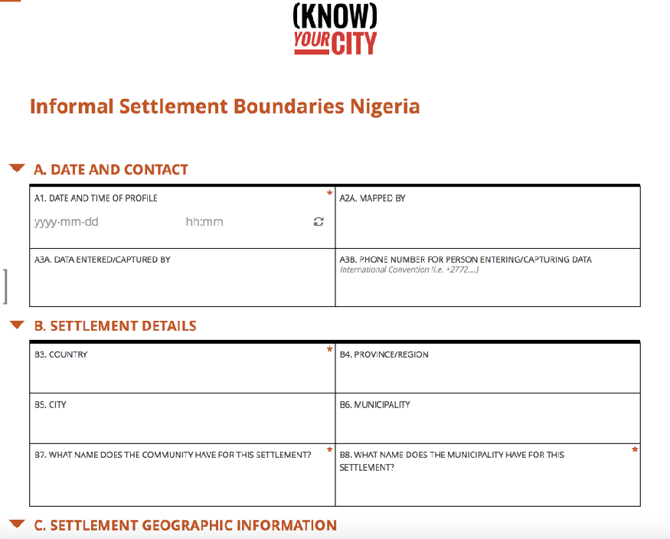
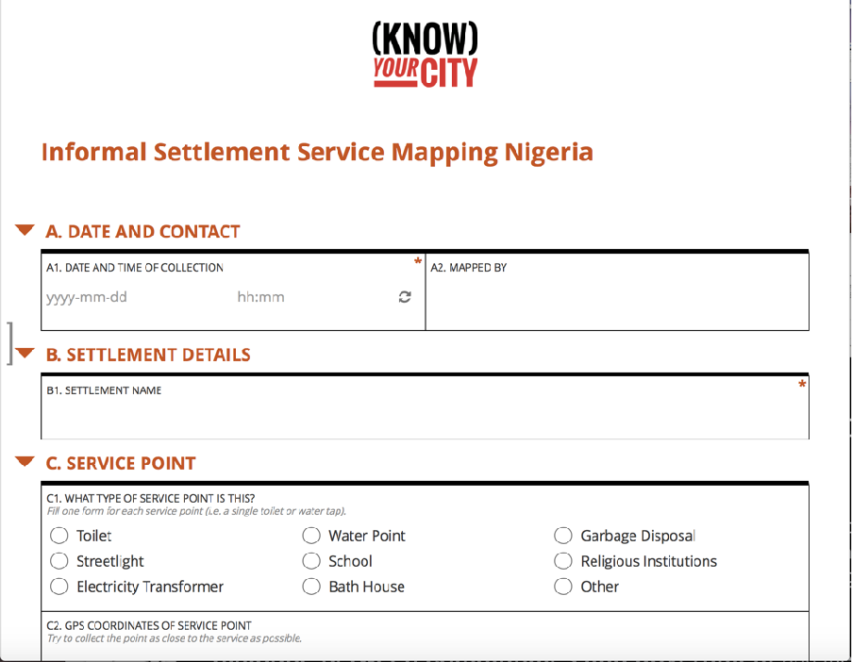
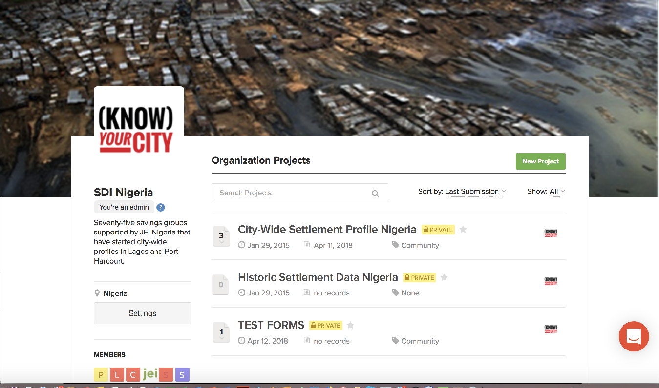
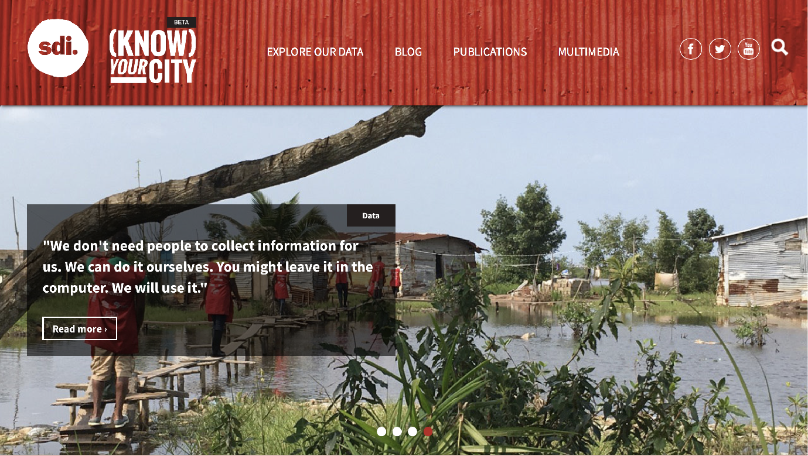
The Tools
The Online Data Platforms
http://knowyourcity.info
https://ona.io
Notes:
Questionnaires used (evolved through many iterations and continue to do so), now mapping is ever more important in addition.

Slide 19
The Team
15 National Federations in Africa and Asia
225 Data Team Members
1 Social Anthropologist
1 Technologist
3 Scientists
4 Startups
The Outputs/Achievements
103 Cities
1238 Settlements verifiably profiled and mapped (+/- 7500 total settlement profiles)
27 000 Services mapped
2000+ community volunteers mobilised for data collection
2 Journal Articles
Working Papers
2 Know Your City Publications
KYC Data recognised by 3rd party academics for NUA (Acuto et al, 2016).
Notes:
It does not take so many people or money, it’s a matter of will and organization….

Slide 20
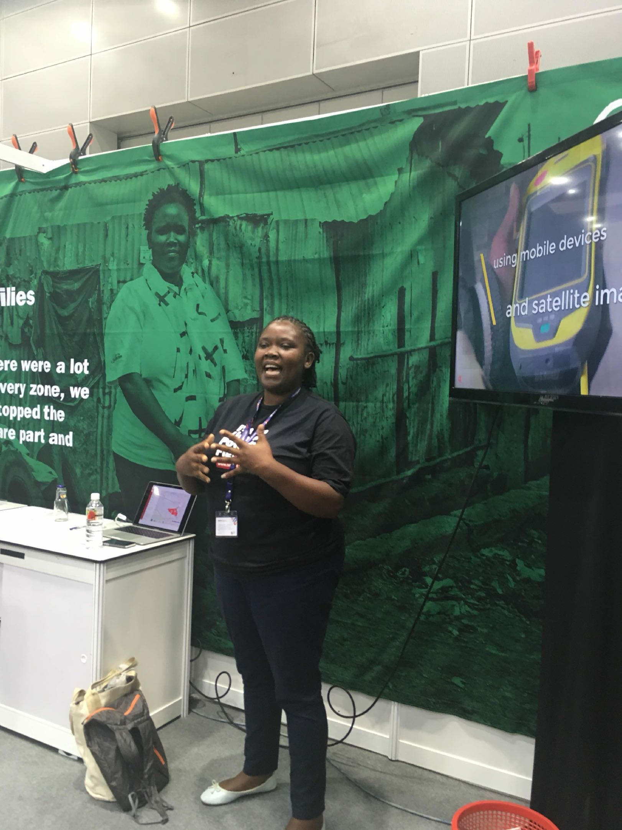
Combine community local knowledge and mobilizing capacity with state-of the-art tech and science.
Notes:
This points to really great uses of technology and information, much better than tech companies can dream of …

Slide 21
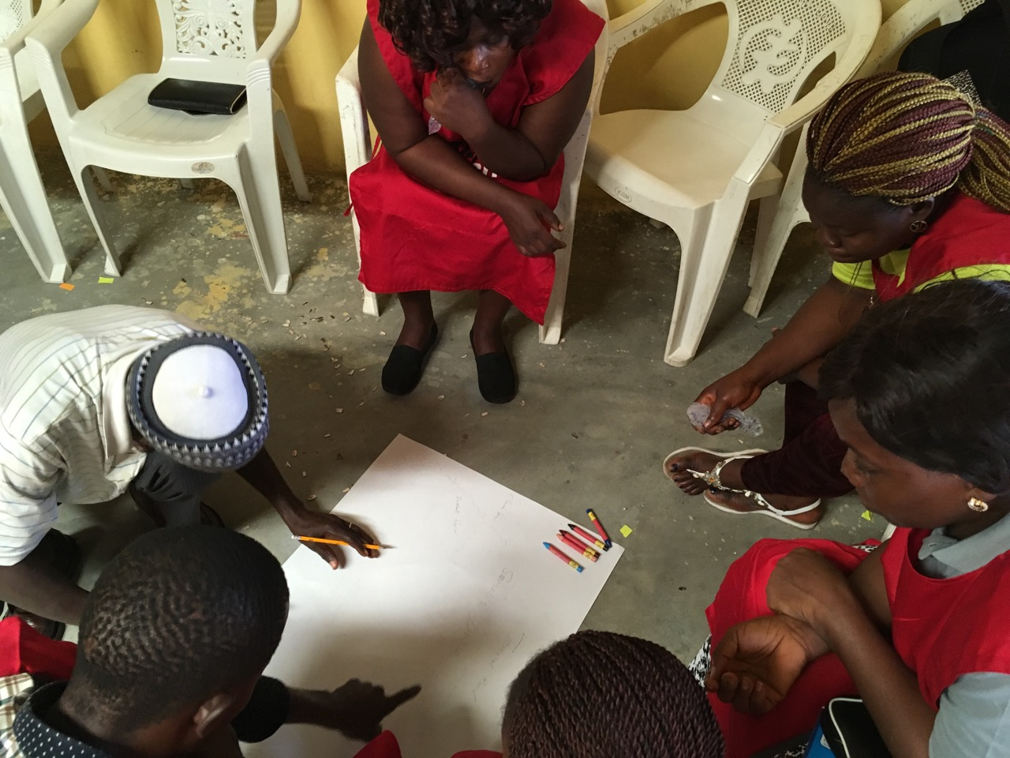
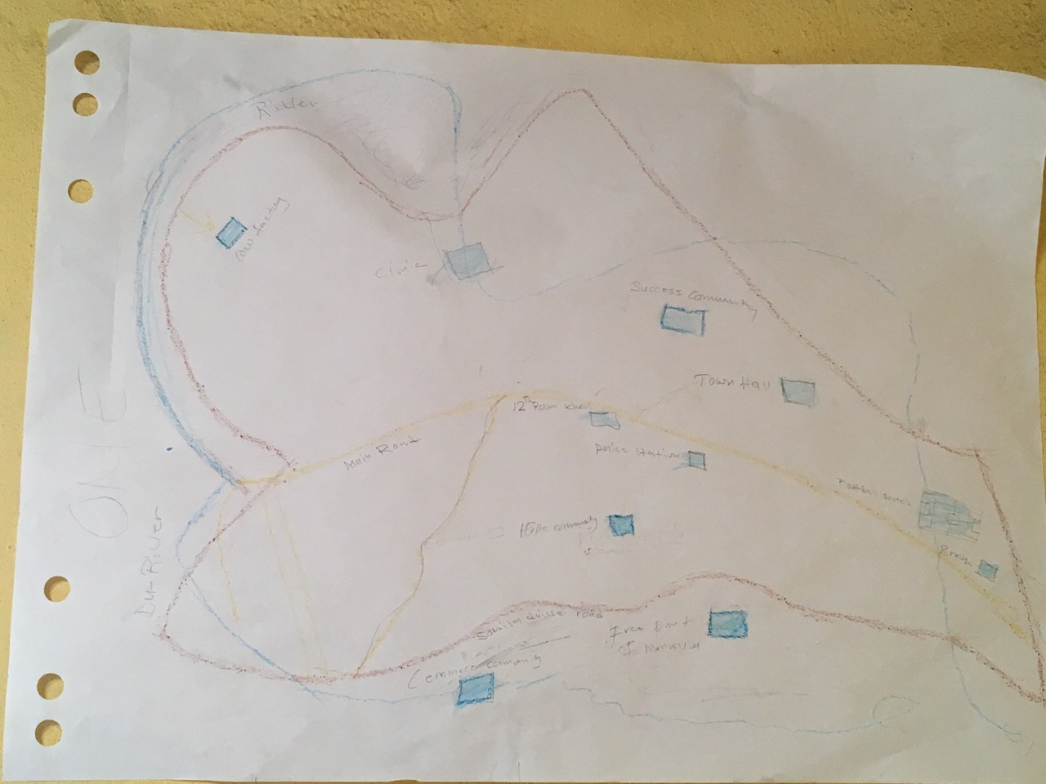
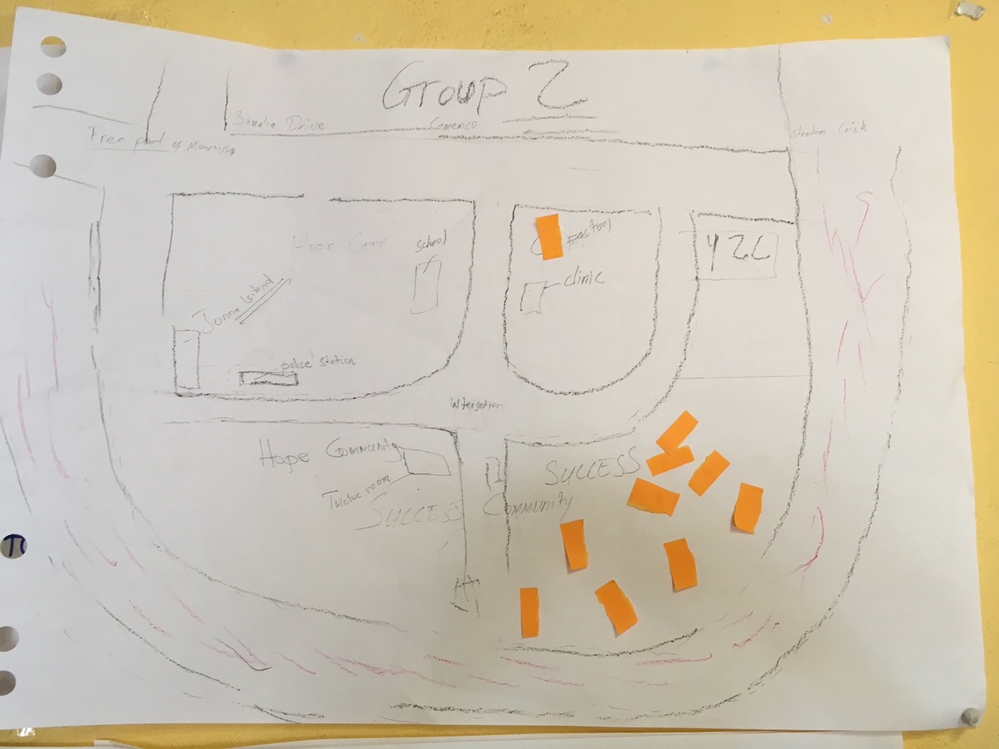
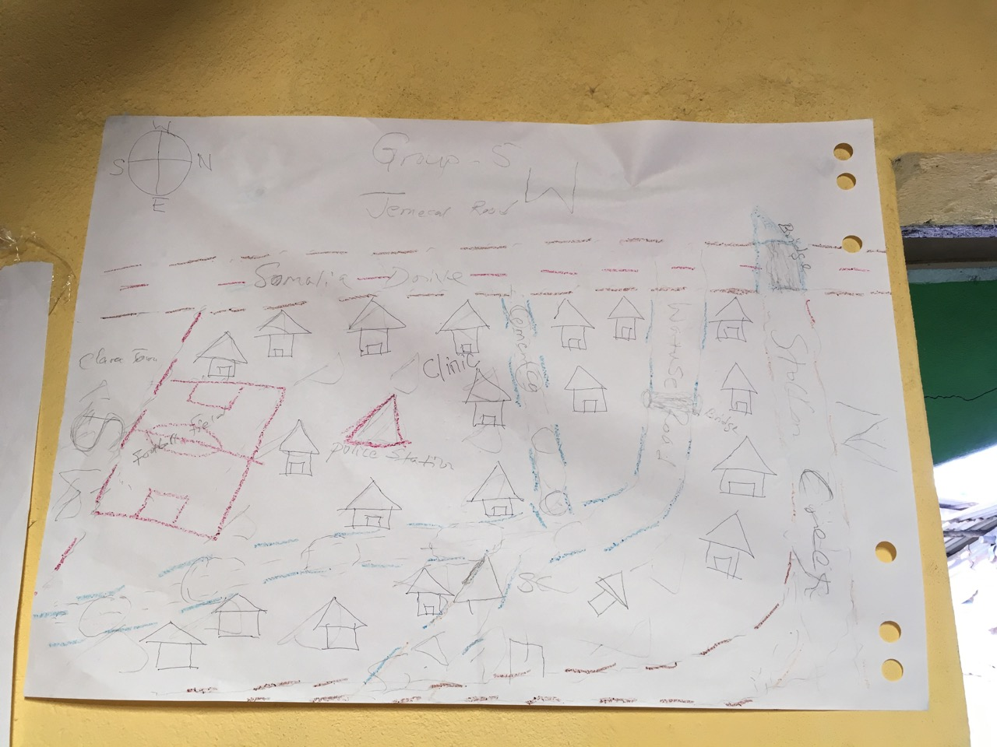
Notes:
Maps are a fundamental point of collective coordination and self-understanding. The starting points were quite basic, but each conveyed important ideas.

Slide 22
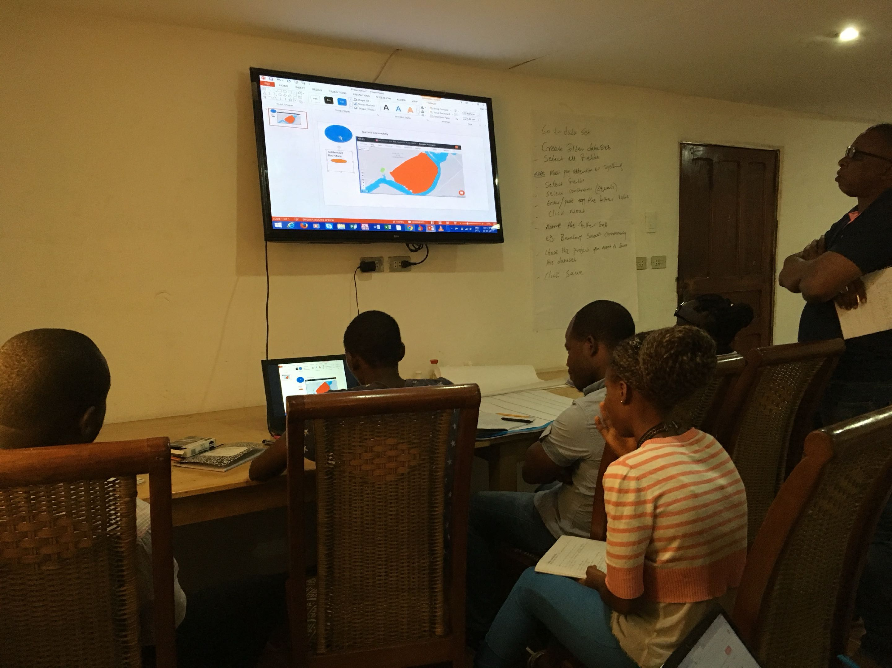
Notes:
Digitization may seem forced and artificial, but exposes processes of data entry, verification and exposes it to more people helping guarantee better quality and a larger audience. It is also a source of training for local communities, especially younger people. The fact that the data is tangible to local realities makes all the difference.

Slide 23
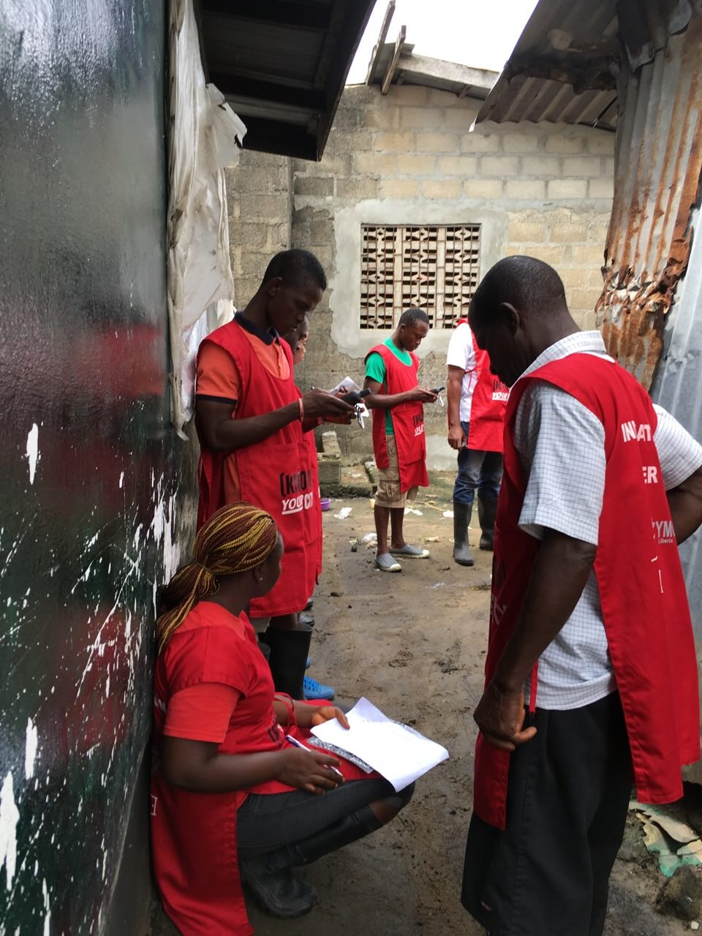
Walk and map every lane and alley…
Notes:
These are some images from Liberia…

Slide 24
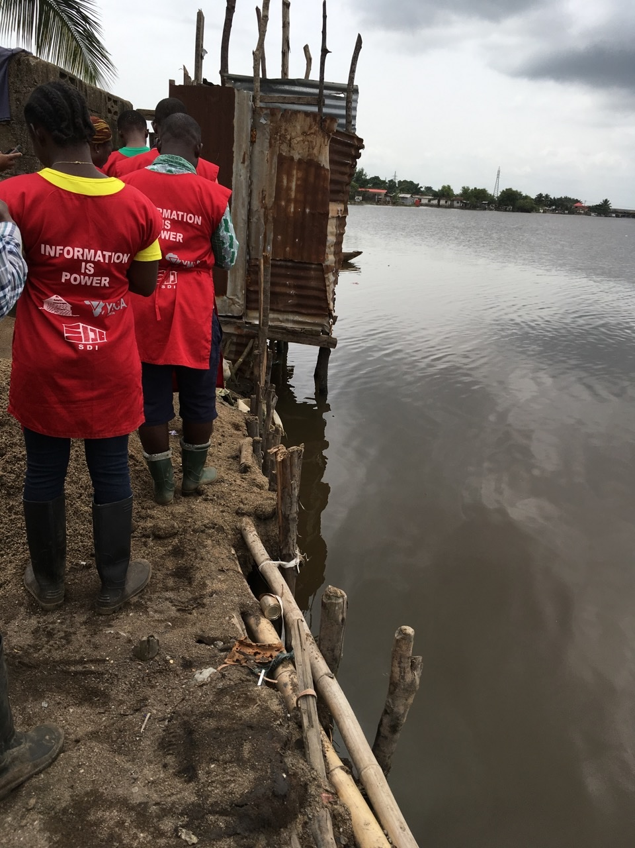
Water’s edge…
Notes:
Many of the cities of West Africa are Costal and subject to sea level changes, many communities already are building over water, over stilts or landfills, much as happened in now high income cities (what’s the story of your city?).

Slide 25
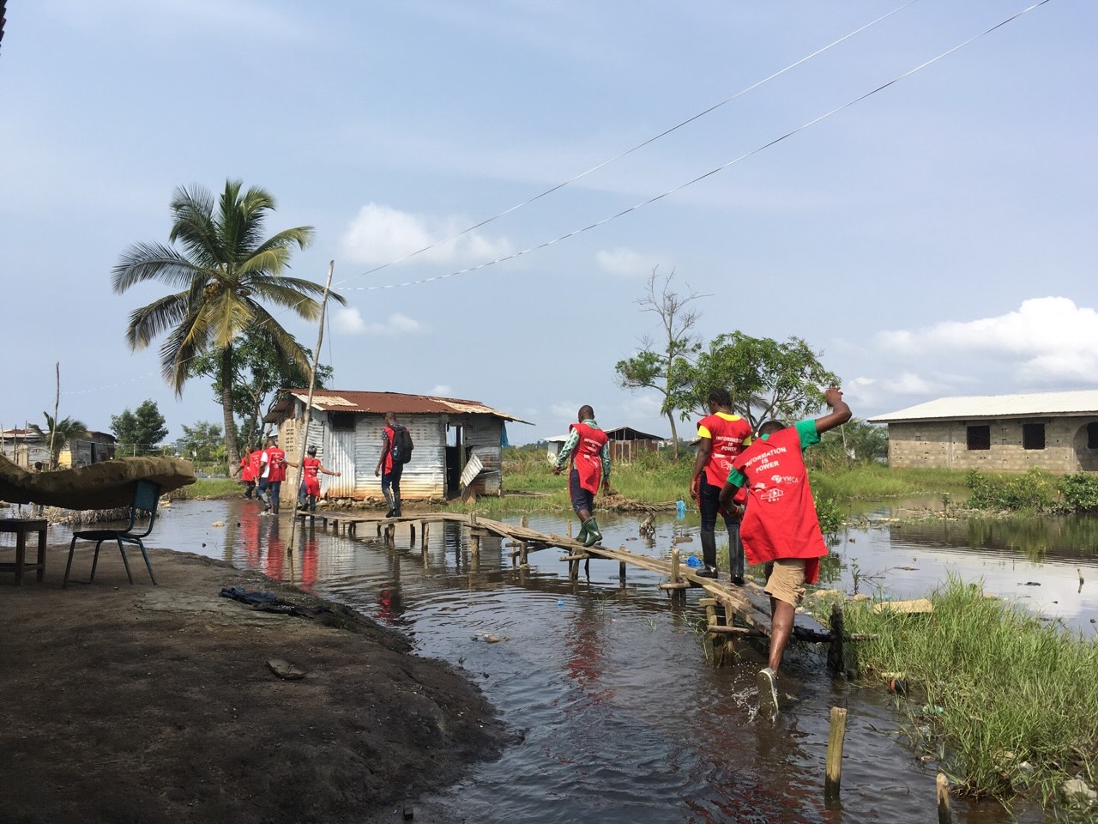
Notes:
You get the idea, much to do.

Slide 26
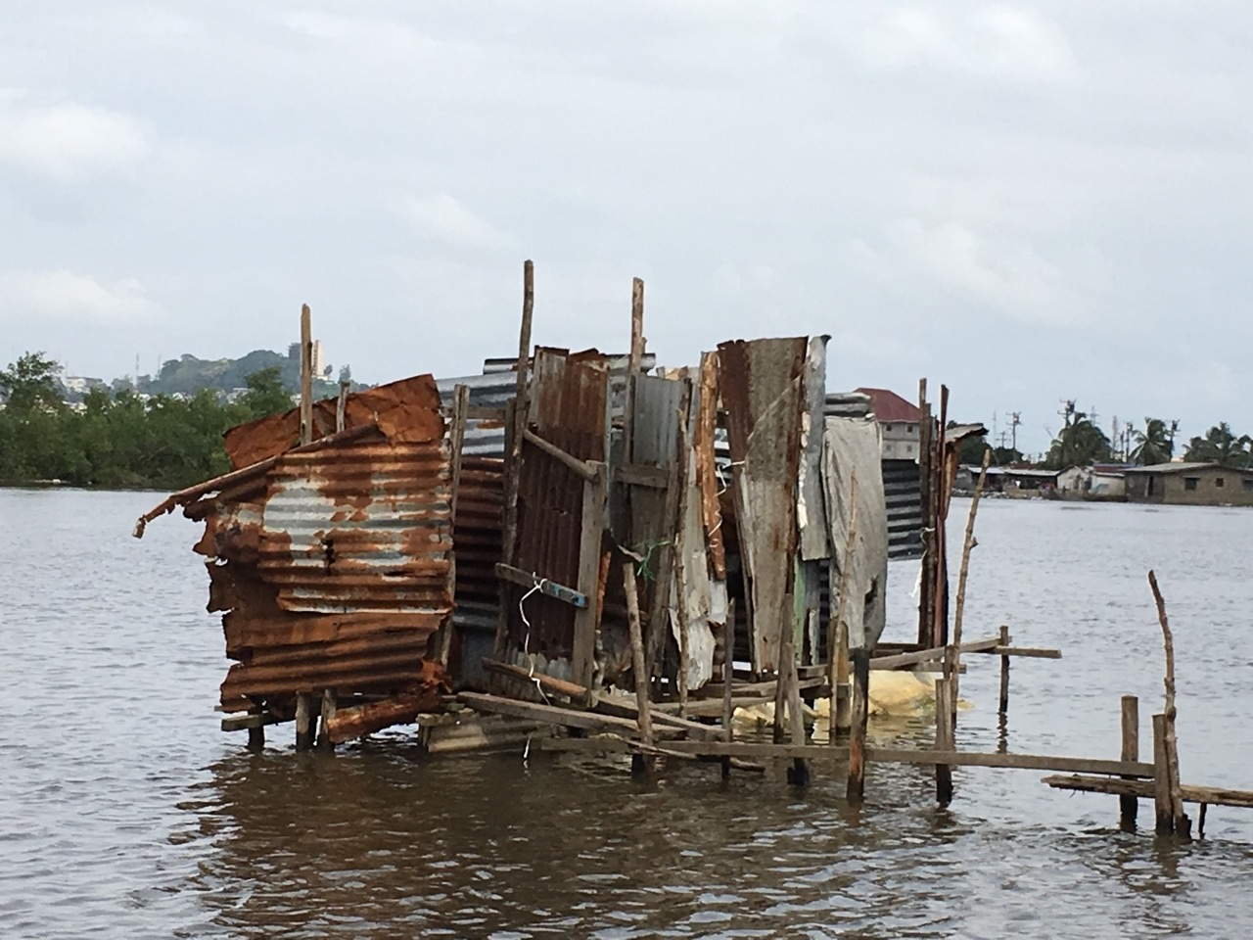

Slide 27
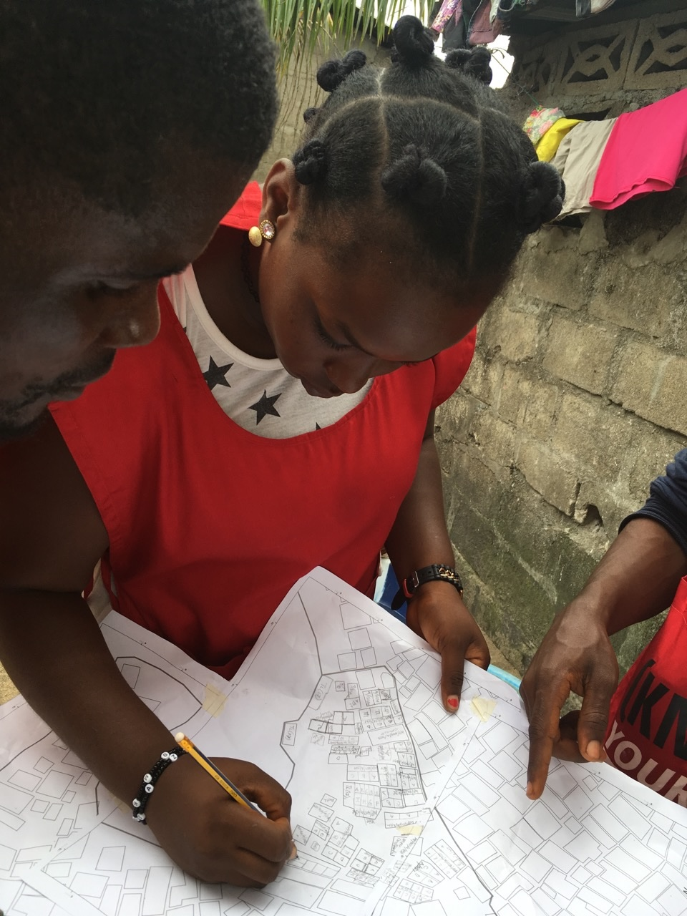
Every household.

Slide 28
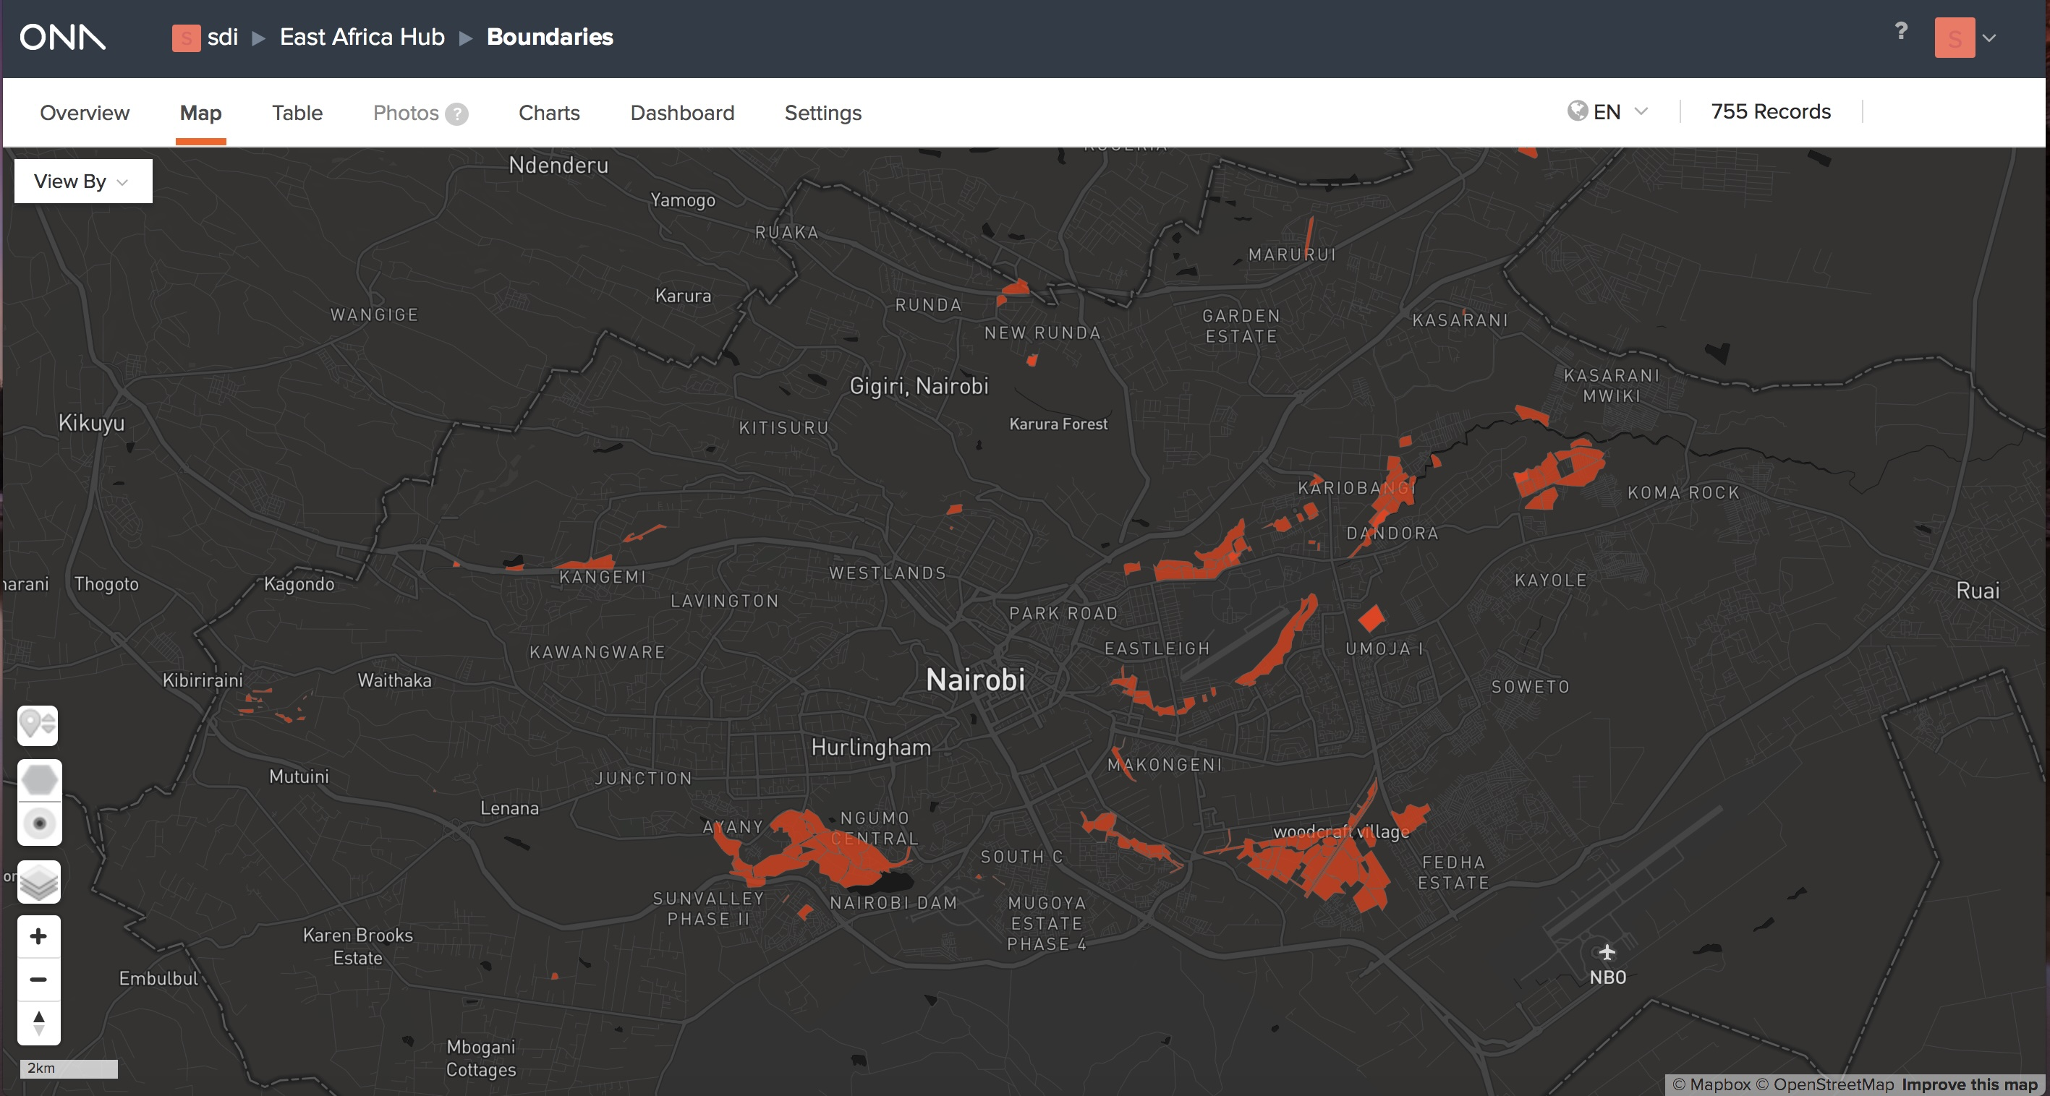
City-wide slum map of Nairobi County, Kenya
Credit: SDI Kenya

Slide 29
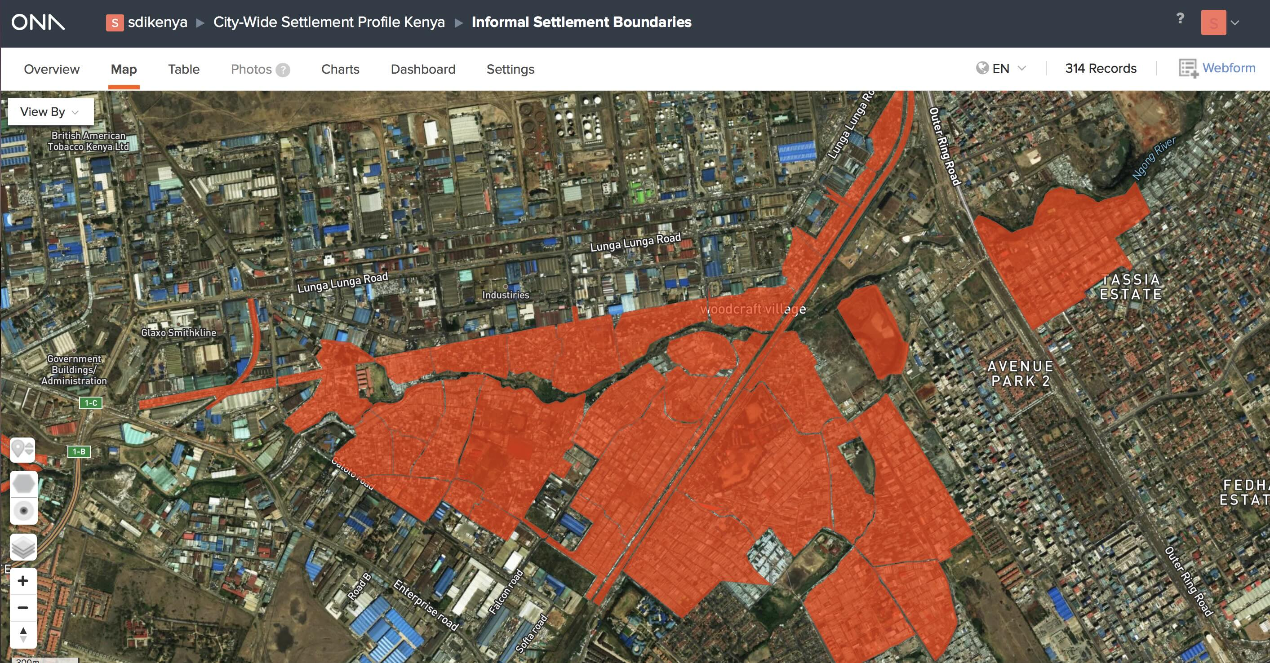
Mukuru Villages: Nairobi County, Kenya
Credit: SDI Kenya

Slide 30
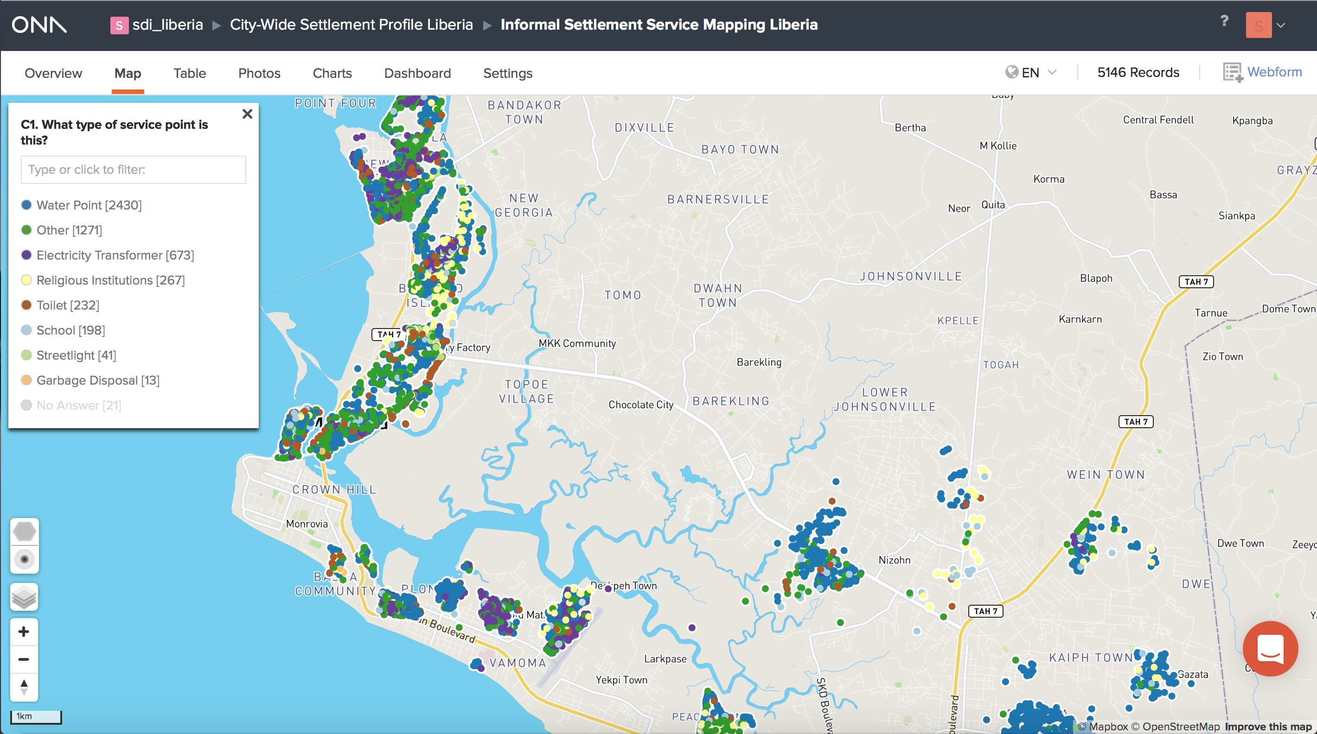
City-wide slum services map of Greater Monrovia, Liberia
Credit: Liberia SDI Alliance
Notes:
Many of these maps become tools to understand (and find) access to shared amenities, these often break and are not functional so we attempted to create “311 type systems” to collaborate in understanding such issues between communities and municipal agencies.

Slide 31
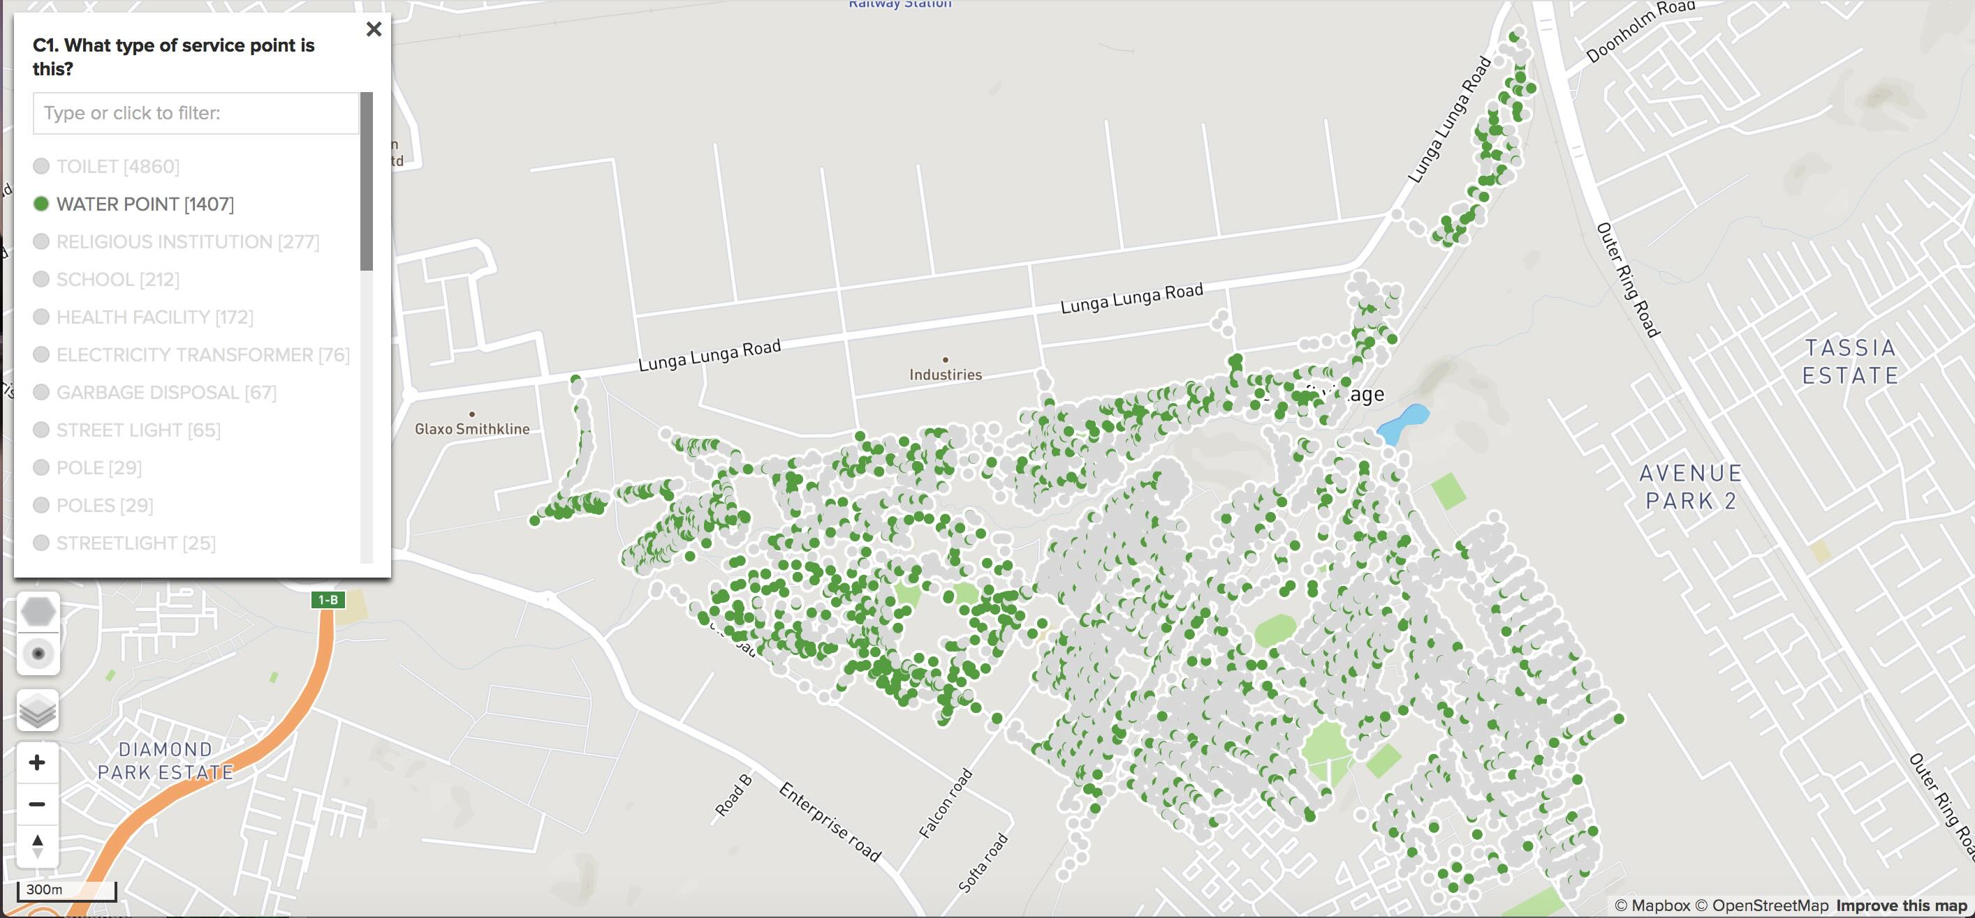
Water points in Mukuru Villages: Nairobi County, Kenya
Credit: SDI Kenya
Notes:
Once invented these methods can travel immediately to communities all over the world.

Slide 32
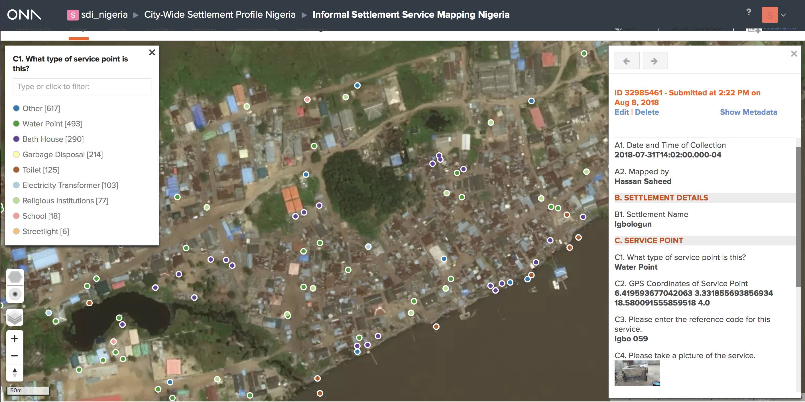
Geo-tagged and photographed water point in Lagos, Nigeria
Credit: Nigeria SDI Alliance
Notes:
As you can see…

Slide 33
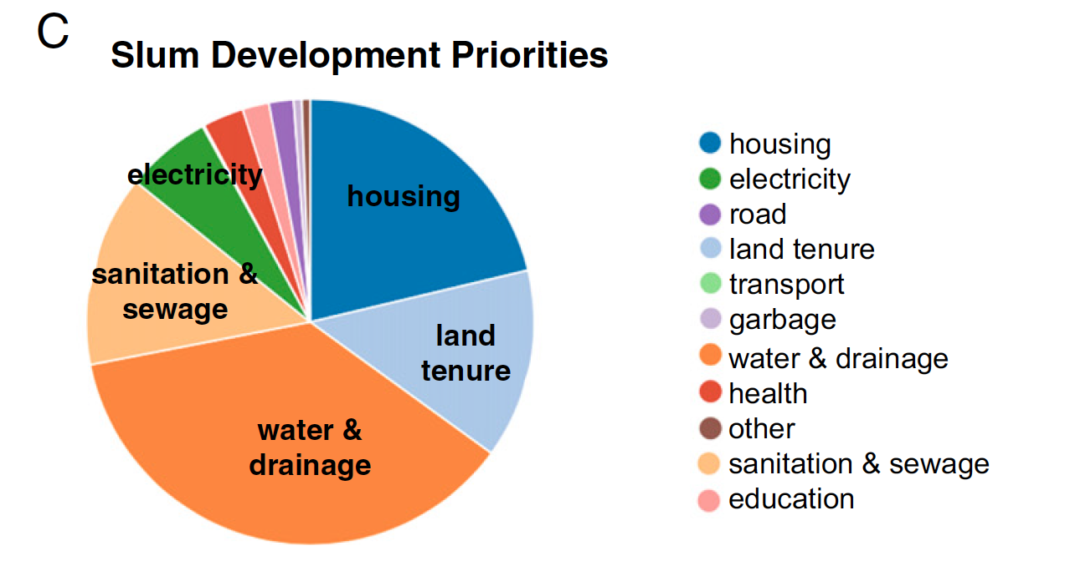
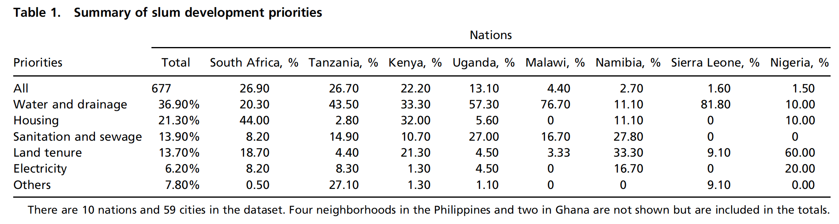
Some Summary Results
https://www.pnas.org/doi/full/10.1073/pnas.1606033114
Notes:
Part of the work of synthesis is in understanding common problems and possible solutions. This is a summary from one of our papers. Typically infrastructure and services that are heavier and more difficult (sanitation, drainage) are much less present than lighter ones (power), which can be improvised and then improved by local actors. There is in this sense a hierarchy of difficulty of types of infrastructure and services.

